Slide 1

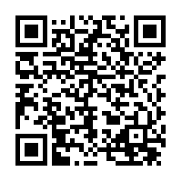
Learning-Based Methods with Human in the Loop for Entity Resolution
Sairam Gurajada
Lucian Popa
Kun Qian
Prithviraj Sen
IBM Research – Almaden
CIKM Tutorial, November 3rd 2019

Slide 2
What is Entity Resolution
Entity Resolution (ER)
Long-standing research problem, started in the late 60’s [Fellegi and Sunter, 1969], still very active
“Recognize, link and fuse various aspects of the same real-world entity”
Many different names and variations:
Record linkage
Record matching
Deduplication
Entity resolution
Entity matching
Reference reconciliation
Merge/purge
Entity linking
Entity integration
Record clustering
…
Itself an entity resolution problem

Slide 3
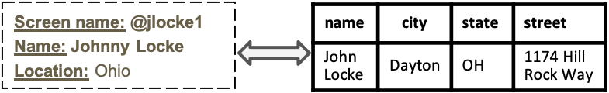
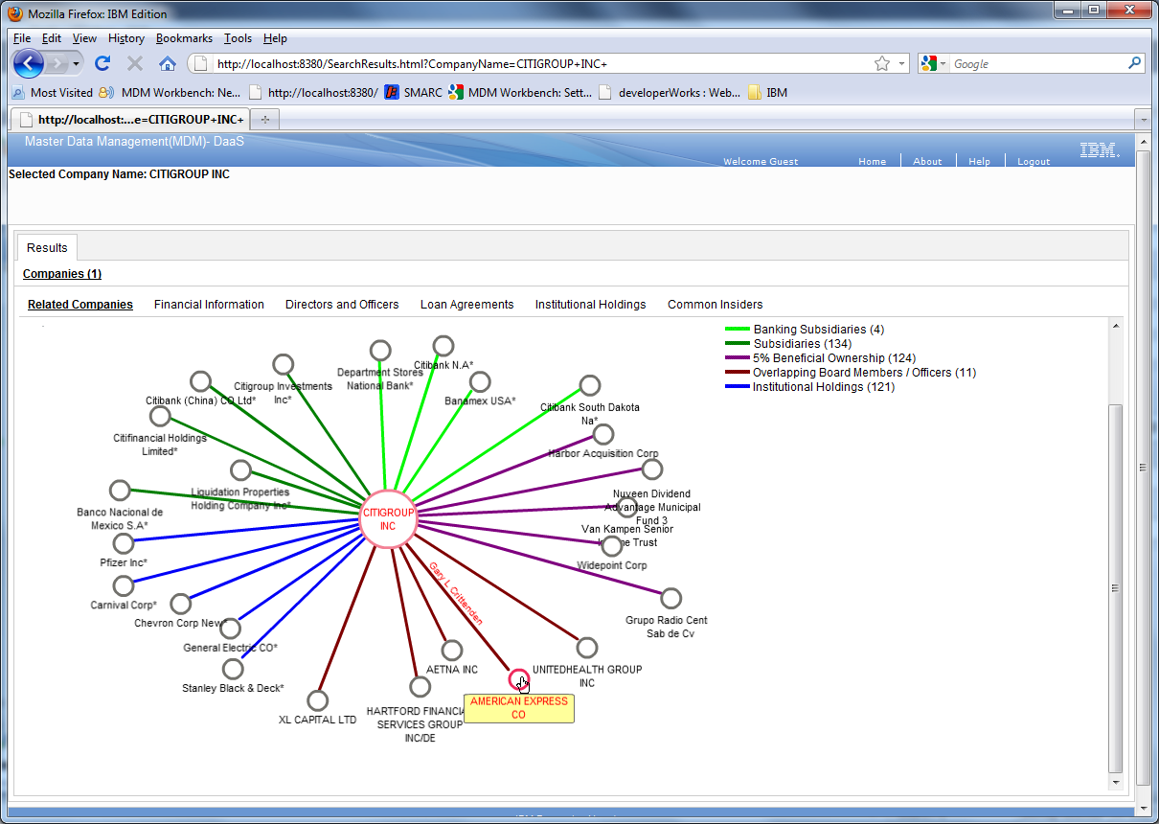
Main Manifestations of ER
“General Electric Corporation” vs.
”General Electric” vs.
“GE Corporation” vs.
“GE”
Name variations for the same entity
Entity name matching and normalization
related to string similarity
Match/link/deduplicate entities
multi-attribute records
Build curated knowledge (structured entities & relationships) from raw data
Includes fusion, curation of attributes, relationship identification.
Structured record matching across datasets
Financial knowledge base integrated from regulatory filings
[Burdick et al, IEEE Data Eng. Bull. 2011]

Slide 4
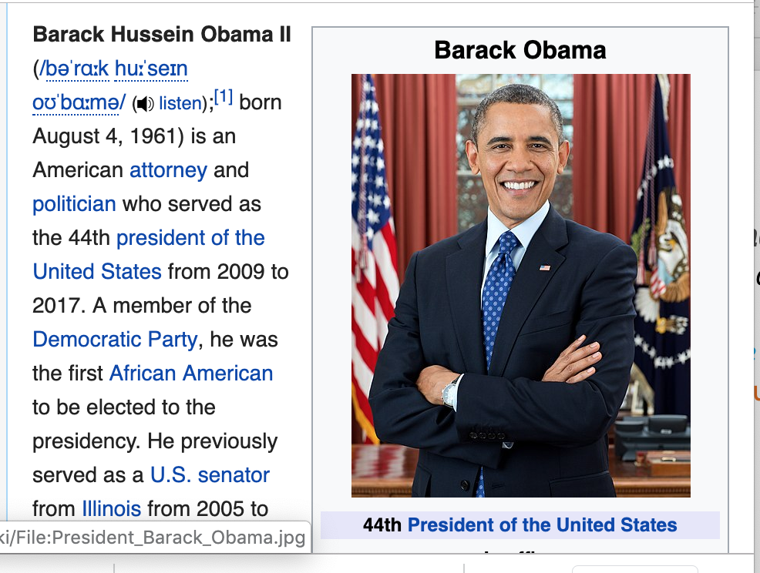
A Bit More Context …
Broader Area: Information integration and Knowledge curation
80’s, 90’s, 00’s: data federation, schema mapping, ontology alignment, etc.
Today: all about making connections at the data-instance level (ER)
ER is ubiquitous:
Within a document/conversation:
Coreference resolution (in NLP)
Within a single database, or across multiple databases
“Traditional” ER (deduplication / record linkage)
Entity linking to existing knowledge base (KB)
Knowledge base (KB) population (see next example …)
I need to know when president Barack Obama was born.
He was born on August 4, 1961.
(Not in this tutorial)
I need to know when president Barack Obama was born.
He was born on August 4, 1961.
Notes:
2) Why is ER good / hard (including human-in-the-loop): next slide:
3) Our Goal: Human-in-the-loop Tools, with machine learning techniques to account for different sometimes conflicting aspects of ER (human-in-the-loop, small labeled data, explainability, automation)
Add the puzzle pieces.
Highlight HIL for explainability, and active learning for Human-in-the-loop and small labeled data.

Slide 5
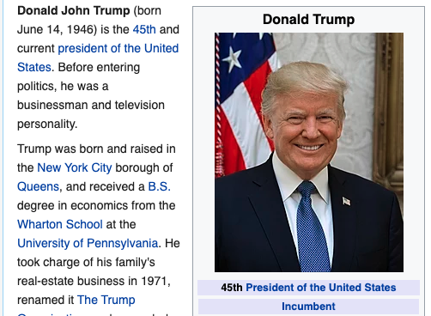
A Bit More Context …
Broader Area: Information integration and Knowledge curation
80’s, 90’s, 00’s: data federation, schema mapping, ontology alignment, etc.
Today: all about making connections at the data-instance level (ER)
ER is ubiquitous:
Within a document/conversation:
Coreference resolution (in NLP)
Within a single database, or across multiple databases
“Traditional” ER (deduplication / record linkage)
Entity linking to existing knowledge base (KB)
Knowledge base (KB) population (see next example …)
I need to know when president Donald J Trump was born.
He was born on June 14, 1946.
(Not in this tutorial)
I need to know when president Donald J Trump was born.
He was born on June 14, 1946.
Notes:
This is the “joke” slide, since Sairam asked about jokes. “This is the updated example. The republican version … insert your own …”

Slide 6

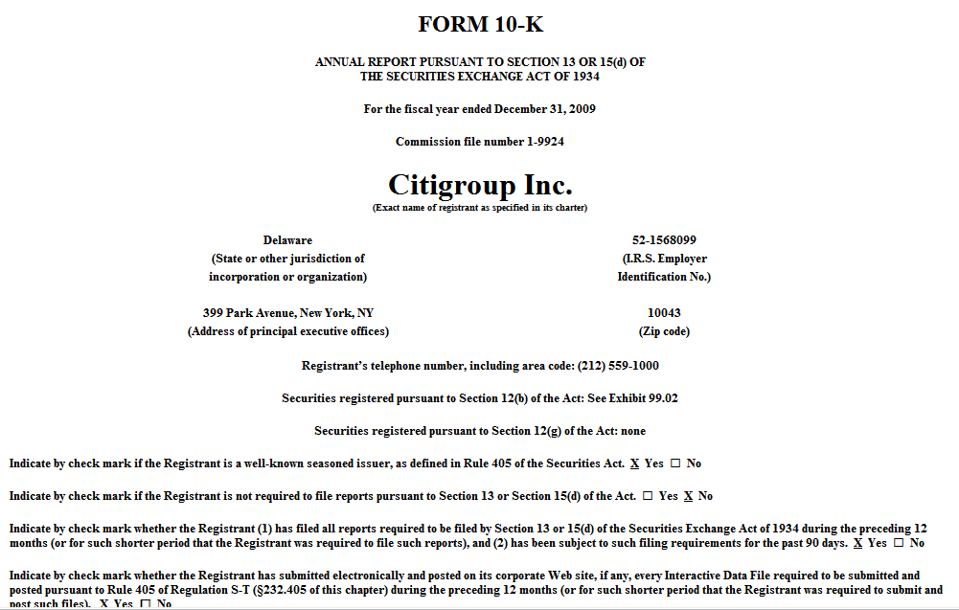

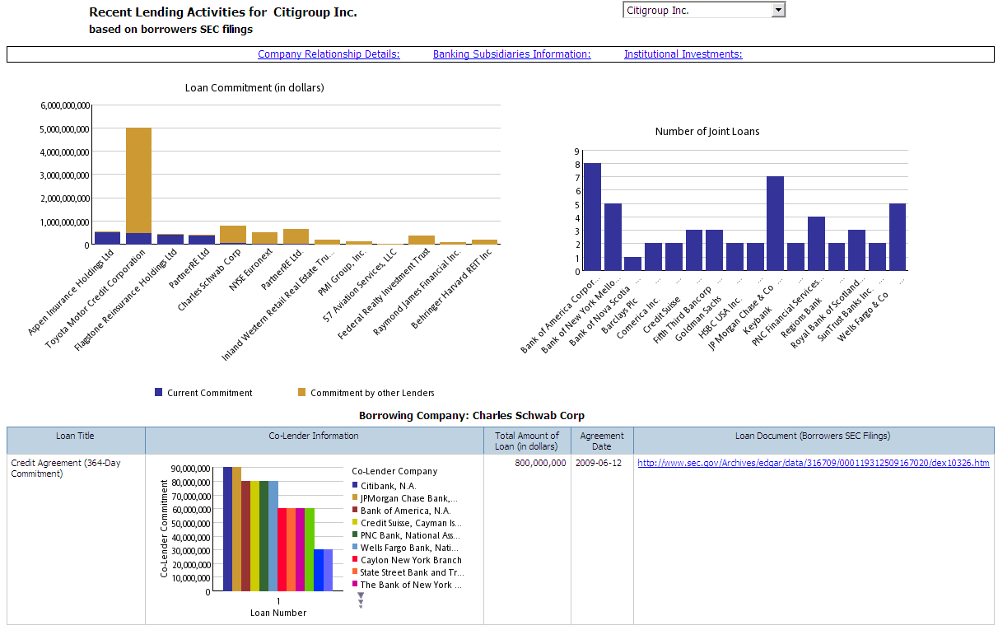
Building A Financial KB from Public Data
[Burdick et al, IEEE Data Eng. Bull. 2011]
Millions of documents
bankruptcies, merger/acquisitions
Event
job changes
Filing
timeline
subsidiaries
insiders
2005 2018
SEC/FDIC Filings of Companies
director, officer
Extract
Entity
Resolution
& Fusion
Company
Person
borrower, lender
transactions
issuer
Security
transactions
Loan
Entity-centric view
Document-centric view
…

Slide 7


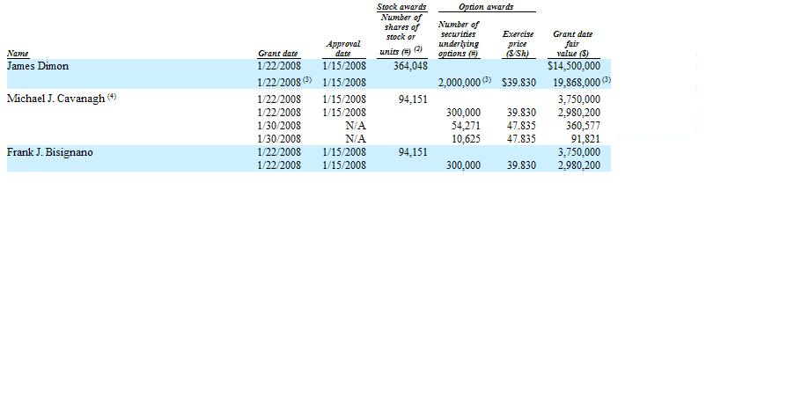

Entity Resolution & Integration across Documents
Do these mentions refer to the same person ?
variability in the person’s name, lack of a key identifier
supporting attributes vary depending on the context
All these facts need to be linked and integrated
Who Is James Dimon?
Signatures
Insider
Transactions
Biographies
Committee memberships
7
Notes:
7
7
7

Slide 8


Why is ER Hard?
Highly dependent on domain, datasets, and types of entities
Different meanings may apply
“Same-as”
“Related-via-some-relationship”
(e.g., subsidiary related to parent-holding company)
Requires human expert, to convey the application semantics
We de not want to burden the human too much either
Person
Screen name: @jlocke1
Name: Johnny Locke
Location: Ohio
name | city | state | street
John Locke | Dayton | OH | 1174 Hill Rock Way
…
Company
Bank of America N.A.
Same-as
Bank of America National Association
Isabella Bank | Mt. Pleasant, MI
(a bank entity)
Isabella Bank Corp | Mt. Pleasant, MI
(parent holding company)
Subsidiary-of
Same-as

Slide 9

Requirements of an Ideal ER System
Industrial-strength accuracy
Cannot afford too many errors!
High-accuracy
Reusable, Explainable, Scalable
Explainable Representation
representation for entity algorithms
facilitates transparency, reasoning and customization
facilitates scalable execution
The (often conflicting) requirements of ER
Small Labeled
Data
Learning
Human in the Loop
Human-in-the-loop Learning
Machine and human expert learn together via (small number of) relevant examples or user interactions

Slide 10
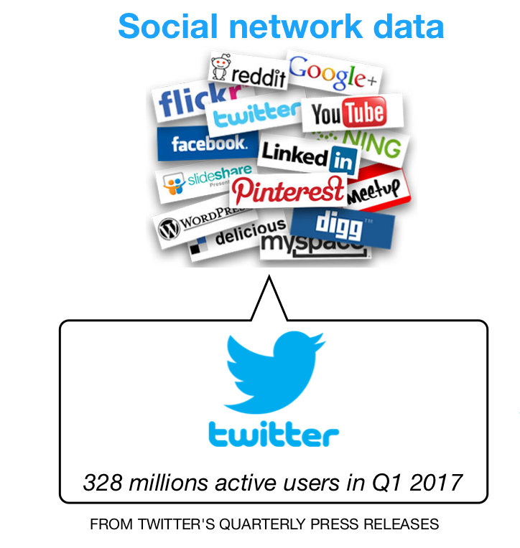
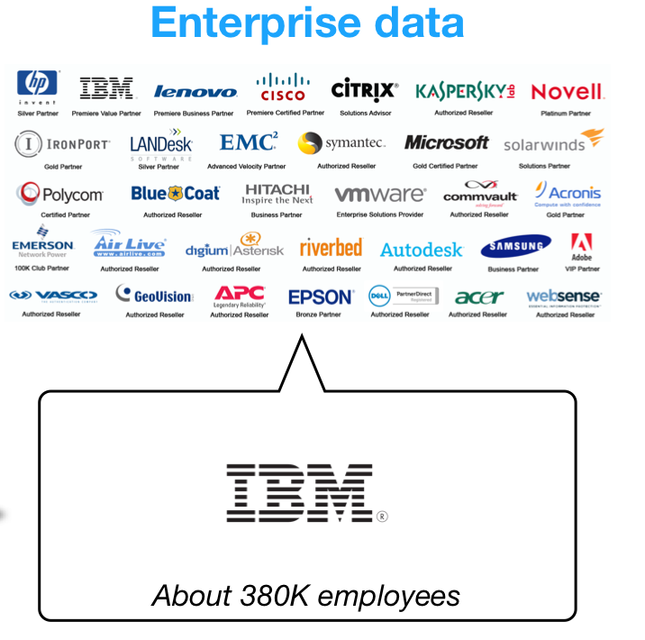
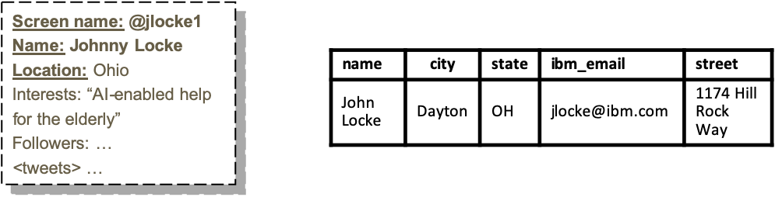
An ER Flow
r₂₀₇
s₄₅
“Find IBM voices on Twitter that are experts on X”
…
Raw entities/records
O(10¹⁴) pairs in the cross-product!
Block into smaller parts, containing records that have a chance to match:
{ (r₁, s₁), (r₂, s₈) …} , {(r₃, s₃), (r₇, s₉), …}
Blocking
(Pairwise)
Matching
r₂₀₇
s₄₅
Matching based on various similarities of the attributes
r₆₇
s₄₅
r₂₀₇
s₄₅
Unified representation of an entity
Clustering
r₆₇
Linked/fused entities

Slide 11
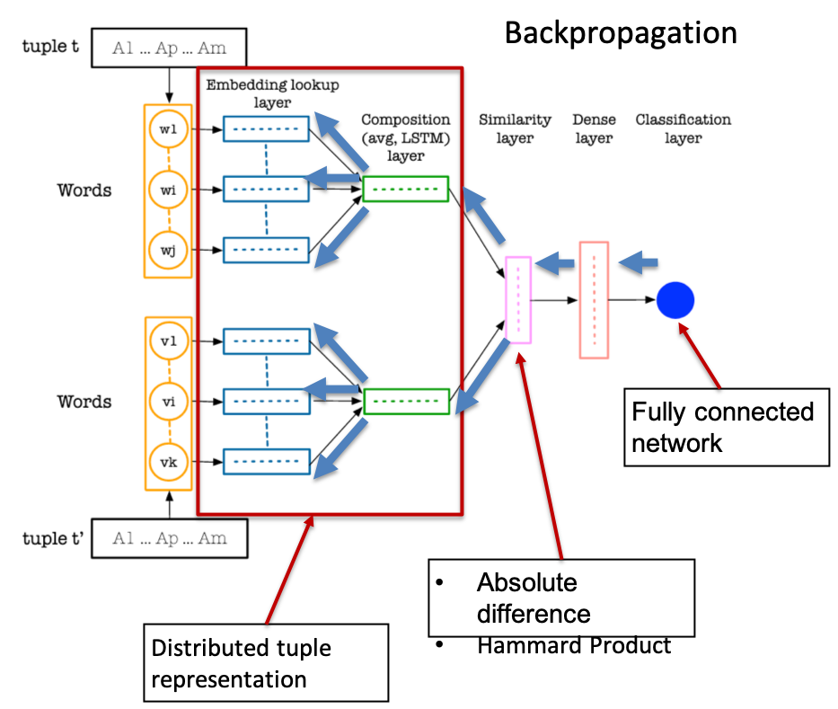
Examples of ER Models
r₂₀₇
DL Model
(from [Ebraheem et al., VLDB’18])
s₄₅
…
Raw entities/records
Feature engineering required
More explainable
Identify/develop matching functions
Jaccard, Jaro-Winkler, specialized name
matching, geo-location proximity, etc.
Rules:
r.lastName = s.lastName
∧ FirstNameMatch (r.firstName, s.firstName)
∧ JaccardSim (r.Interests, s.jobDesc, 60)
Blocking
(Pairwise)
Matching
Clustering
No feature engineering
Less explainable
Decision Trees, Declarative FO Constraints, MLNs
SVMs, Random Forests (less explainable)
Linked/fused entities

Slide 12
Outline of the Rest of the Tutorial
Explainability
Crowd-sourcing
Active Learning
Deep Learning

Slide 13

Explainable Representation vs. Learning
Corleone/Falcon
[MLN Learning]
Kok and Domingos, ICML’10
[PSL] Bach et al, JMLR’17
Crowdsourcing
Probabilistic
Active Learning
Deep Learning
Arasu et al, SIGMOD’10
[SystemER] Qian et al, CIKM’17
Learning-based methods
Learn algorithms that are explainable
[ExplainER] Ebaid et al, ICDE’19
Mentions
Blocking
Matching
Clustering
Resolved Entities
Rules, Constraints, High-level PL
Recursive rules for clustering and collective ER
Explainable representation
languages
Rules & Decision Trees
[Dedupalog] Arasu et al, ICDE’09
[Markov Logic Networks] Singla and Domingos, ICDM’06
[PSL] Bach et al, JMLR’17
[Declarative Entity Linking] Burdick et al, ICDT’15/17
[HIL] Hernandez et al, EDBT’13

Slide 14
Basic Models: Rules, Decision Trees
Rules have been used in many ER solutions and papers.
[Chaudhuri et al, VLDB’07], [Arasu et al, SIGMOD’10], [Wang et al, VLDB’11]
Typically, they appear as DNF boolean formulae (or in restricted forms)
used to produce pairwise matches (when evaluated to true):
f₁(attr₁, attr₁’, 𝛳₁) ∧ f₂(attr₂, attr₂’, 𝛳₂) ∧ … ∧ f_{k}(attr_{k}, attr_{k}’, 𝛳_{k})
⋁
…
⋁
g₁(attr₁, attr₁’, 𝛳₁) ∧ g₂(attr₂, attr₂’, 𝛳₂) ∧ … ∧ g_{l}(attr_{l}, attr_{l}’, 𝛳_{l})
Decision trees:
Popular tree-representation of a DNF formula, used especially in learning
Often replaced with random forests (ensembles of decision trees)
More robust (leads to less over-fitting), but also less interpretable
Each f_{i} is some similarity function, applied on a pair of attributes, with some threshold 𝛳
Name sim > 0.95
no
yes
No match
Street sim > 0.85
no
yes
Phone sim > 0.85
Match
no
yes
No match
Match

Slide 15
Next:
More powerful representations for entity resolution logic …
Various types of semantics

Slide 16
Dedupalog [Arasu et al, ICDE 2009]
One of the first approaches to merge declarative constraints and entity resolution.
Main ideas:
Constraints occur naturally in data cleaning, and in ER, in particular
Ex: Each paper has a unique publication venue (or, a unique year)
Collective entity resolution via Datalog-style of rules
Multiple types of entities can be resolved together (e.g., papers, venues)
Multiple stages of ER
Pair-wise matching + clustering
Soft constraints as a relaxation
In general, the constraints may be unsatisfiable when interpreted in a hard, logic-sense
A. Arasu, C. Re, and D. Suciu.
Large-Scale Deduplication with Constraints using Dedupalog. In ICDE, 952-963, 2009.

Slide 17
A Dedupalog Specification
Clustering relations (will contain equivalent entities)
PaperRefs
ID | Title | Venue | Year | Authors
p1 | Cluster Aggregation | ICDE | 2005 | “Gionis; Mannila; Tsaparas”
p2 | Clustering Aggregation | International Conf. on Data Engineering | 2005 | “Gionis”
p3 | Collective entity resolution in relational data | Data Eng. Bull | 2007 | “Bhattacharya; Getoor”
Paper*
ID | ID’
p1 | p2
… | …
ER Task
v | v’
ICDE | International Conf. on Data Engineering
… | …
Venue*
Soft constraints
complete
incomplete
Paper* (p, p’) ⟷ PaperRefs (p, t, …) ∧ PaperRefs (p’, t’, …) ∧ TitlesSimilar (t, t’)
Paper* (p, p’) ⟵ PaperRefs (p, t, ...) ∧ PaperRefs (p’, t’, ...) ∧ TitlesVerySimilar (t, t’)
Hard constraints
¬Paper* (p, p’) ⟸ PaperRefs (p, t, _, y, _) ∧ PaperRefs (p’, t’, _, y’, _) ∧ y ≠ y’
Collective constraints
(can be hard or soft; can be recursive)
Venue* (v, v’) ⟸ PaperRefs (p, t, v, …) ∧ PaperRefs (p’, t’, v’, …) ∧ Paper* (p, p’)

Slide 18
Dedupalog: Further Remarks
Softening the constraints, to allow (some) violations, is essential for the framework.
Paper* (p, p’) ⟵ PaperRefs (p, t, ...) ∧ PaperRefs (p’, t’, ...) ∧ TitlesVerySimilar (t, t’)
If this were a hard constraint, then we would likely get inconsistencies (e.g., with the constraint below).
¬Paper* (p, p’) ⟸ PaperRefs (p, t, _, y, _) ∧ PaperRefs (p’, t’, _, y’, _) ∧ y ≠ y’
While constructing the clusters, Dedupalog aims to:
Keep the violations of soft constraints at a minimum, while all the hard constraints are satisfied.
The general optimization problem is intractable; but, constant-factor approximation for a subset of Dedupalog.
Dedupalog is an expressive language (iff, negation, recursion, etc.)
But:
A user has a lot of degrees of freedom (e.g., on which constraints to soften and when).
Explainability is only at the specification level (not implementation).
Not easy to explain how the algorithm chooses which violations are kept and which not.

Slide 19
Markov Logic Networks
First-order probabilistic reasoning over uncertain data.
General framework introduced in [Richardson and Domingos, Mach. Learning 2006]
Applied to ER in [Singla and Domingos, ICDM 2006]
Weighted first-order formulas 𝜑₁, …, 𝜑_{n}, interpreted as soft constraints.
Like in Dedupalog, the formulas are allowed to have violations.
The semantics is defined, formally, via a set of possible worlds.
Additional facts according to World 1
Additional facts according to World 2
True facts (given)
Eq (r1, r2)
Eq (r1, r3)
Eq (r2, r3)
r1
John Smith | OH | Chase
r2
JR Smith | Cleveland | …
r3
John R Smith | … | Cleveland Hosp.
r1
John Smith | OH | Chase
r2
JR Smith | Cleveland | …
r3
John R Smith | … | Cleveland Hosp.
Eq (r2, r3)
P (World) depends on the weight of each 𝜑, multiplied by # of true groundings (i.e., non-violations) of 𝜑

Slide 20
Example of MLN Rules for Entity Resolution
component | product | OS
Integrated Camera driver | Lenovo T420S | Windows 8
Camera driver | T420S | Windows Operating System
ER on fields (made of multiple tokens)
r1
r2
(w)
HasWord (f1, t1 ) ∧ HasWord (f2, t2 ) ∧ Eq(t1, t2) → Eq (f1, f2)
Not true in first-order sense!
But: “equality of t1 and t2 is evidence that f1 and f2 may be the same”
HasWord (“Lenovo T420s”, “T420s”) ∧ HasWord(“T420s”, “T420s”) ∧ Eq (“T420s”, “T420s”) → Eq (“Lenovo T420s”, “T420s”)
grounding
If weight w is high, then any world where this is a true grounding (i.e., the atom Eq (“Lenovo T420s”, “T420s”) is true) becomes more probable
Elevate ER on records (made of multiple fields)
(w₁)
HasField(r1, “product”, f1 ) ∧ HasField(r2 , “product”, f2 ) ∧ HasWord(f1, t1 ) ∧ HasWord(f2, t2 ) ∧ Eq(t1, t2) → Eq (r1, r2)
(w₂)
HasField(r1, “component”, f1 ) ∧ HasField(r2 , “component”, f2 ) ∧ HasWord(f1, t1 ) ∧ HasWord(f2, t2 ) ∧ Eq(t1, t2) → Eq (r1, r2)
…
Captures the essence of the [Fellegi and Sunter, 1969] model for record matching
Notes:
The intuition for the first formula is the following. Even if the formula is not true in the absolute first-order sense, the equality of t1 and t2 is evidence that f1 and f2 may be the same”

Slide 21
PSL
Like MLN, Probabilistic Soft Logic (PSL) also uses weighted first-order rules.
However, different from MLNs, each truth atom can take a continuous value in [0, 1]
(w)
HasWord (f1, t1 ) ∧ HasWord (f2, t2 ) ∧ Eq(t1, t2) → Eq (f1, f2)
HasWord (“Lenovo T420s”, “T420s”) ∧ HasWord(“T420s”, “T420s”) ∧ Eq (“T420s”, “T420s”) → Eq (“Lenovo T420s”, “T420s”)
grounding
In a MLN world: this atom is either true (1) or false (0)
In PSL: this atom’s truth is a number in [0, 1]
The inference problem in PSL becomes a convex optimization problem, where the goal is to minimize the distance to satisfaction for each of the formulas
More efficient, in practice, than MLN inference.
Stephen H. Bach, Matthias Broecheler, Bert Huang and Lise Getoor. Hinge-Loss Markov Random Fields and Probabilistic Soft Logic. In JMLR, 18(109):1-67, 2017

Slide 22
More on MLN and PSL
Both are part of a broader family of probabilistic programming languages
See, for example:
Besides inference (e.g., using MLN or PSL models for predicting ER matches), the other important problem is learning
Two ways in which learning for MLN/PSL can be employed:
Expert writes the set of first-order formulas (either MLN or PSL) as a template for the application
Then system learns the weights based on the data
Harder problem:
Learn both the formulas (also called structure learning) and the weights
L. De Raedt, A. Kimmig, and H. Toivonen. ProbLog: A probabilistic Prolog and its applications to link discovery. In IJCAI, pp. 2468-2473, 2007
Stanley Kok and Pedro Domingos. Learning Markov Logic Networks Using Structural Motifs. In ICML, pp. 551-558, 2010

Slide 23
So far, we have seen:
Dedupalog: combinations of hard and “soft” constraints, together with heuristics to minimize the number of violations
Not entirely declarative: The user must be aware of how the system interprets the rules
Probabilistic approaches (MLNs, PSL)
FO syntax is a guideline, to be interpreted probabilistically
In general, require complex inference; not easy to explain answers
Next:
Purely declarative approach using “link-to-source” constraints
Gives rise to a formal, deterministic, semantics based on certain links
Notes:
We now discuss some recent approaches that have started to focus on specification. These can be put under three categories:
First, we have high-level languages, typically based on rules, which provide operational guidelines for how to match or fuse entities. A good example is Dedupalog, which uses Datalog-like syntax to express combinations of hard and ”soft” constraints, together with heuristics to minimize the number of violations of the soft constraints. In Dedupalog, the user must be aware of how the system interprets the rules, or applies the heuristics. So, this approach is not entirely declarative although it is a step towards ease-of-use.
We then have probabilistic approaches. A very general example here is the one based on Markov Logic Networks, or MLNs. In this approach, we write first-order logic rules, which like in the previous approach also provide a guideline for the computation of entities, but to be interpreted probabilistically. MLN-based approaches often require complex inference that is computationally expensive. Also, it is not always easy to explain the answers to a user.
A third type of approach can be seen as “purely” declarative, logic-based. It uses link-to-source constraints to specify the intended properties of the links between entities. And this gives rise to a formal, and deterministic semantics based on certain links, which is a variation on the standard notion of certain answers.

Slide 24
Declarative Entity Linking
D. Burdick, R. Fagin, P. Kolaitis, L. Popa, and W.-C. Tan. A Declarative Framework for Linking Entities. In ICDT 2015, 25-43. (Also in TODS’16).
Source data
Must create links between ”subsidiaries” and “companies”.
Model the result as a binary link relation.
Subsid
sid
sname
location
s1, “Citibank”, …
Link
Inclusion dependencies, functional dependencies
sid
cid
Link(s1, c1)
Company
Link[sid] ⊆ Subsid [sid], Link [cid] ⊆ Company [cid]
Link: sid → cid
cid
cname
hdqrts
c1, “Citigroup”, …
“Link-to-source” constraints:
Disjunctive enumeration of all the reasons for why a link can exist
Link (s, c) → …
sname ∼ cname
∨ …
∃ e,n,t (Exec (e, c, n, title) ∧ contains (title, sname) )
Exec
eid
cid
name
title
e1, c1, “Eugene McQuade”, “CEO, Citibank, N.A.”
Logical specification states the desired properties of the links (“what” not “how”)
Notes:
So, let's take a look at an example of such declarative entity linking. Consider the scenario where we need to link subsidiary records in one database to their parent company records in a different database. More concretely, we need to link subsidiary ids with company ids. First, we model the result of such entity linking as a binary link relation, which then needs to be populated with the "correct" links. For example, if we have these two source records for "Citibank" and "Citigroup", we would like the link relation to contain a link between their ids, given that "Citibank" is an actual subsidiary of "Citigroup".
We then use link-to-source constraints, which together with other types of constraints (not shown here), implicitly define the link relation in terms of the sources. A link-to-source constraint gives a disjunctive enumeration of all the reasons for why a link can exist. In this example, whenever we have a link between a subsidiary and a company then it must be the case that one or more of these matching conditions, shown here, must be satisfied. The matching conditions can be as simple as checking the string similarity of names, or can be more sophisticated and can involve existentially quantified conjunctions of predicates. In this example, the fact that there is an executive who works for Citigroup and whose title contains the string "Citibank" gives an additional reason for why we should link Citibank to Citigroup.
Without going into further details here, this is a logical specification that states the desired properties of the links (the "what" and not the "how").

Slide 25
Why is Such Framework Useful ?
Deterministic logic-based semantics
Maximum-weight repairs & Certain links
repair = set of links that satisfies all the constraints in a hard logical sense
Formal complexity results
Expressive power comparisons [Burdick et al, ICDT’17]
Class of constraints can be increasingly more powerful
Single-link vs. collective entity-linking [Bhattacharya and Getoor, 2007]
SamePublication (p1, p2) → …
SameVenue (conf1, conf2) …
SameVenue (conf1, conf2) → …
SamePublication (p1, p2) ...
Probabilistic matching [Fellegi & Sunter, 1969]
Linear MLNs
Surprisingly, probabilistic approaches can be captured by the deterministic approach.
Results/algorithms can be transferred by exploiting such connection [Burdick et al, ICDT’15]
PTIME results from declarative entity linking ⇒ PTIME results (not known before) for linear MLNs
Provides rigorous foundations behind practical languages for entity resolution…
Notes:
So, why is such framework useful? Well, essentially, it allows one to reason at the specification level without worrying about the specific implementations or algorithms. For example, we can relate multiple entity-linking specifications via static analysis of the constraints. In particular, we can define notions of containment and equivalence of entity-linking specifications. We can also analyze the expressive power of the entity-linking frameworks under various languages of constraints, and this is something that was pursued in depth in this recent paper by Burdick et al in 2017.
Somewhat surprisingly, two popular probabilistic approaches can be captured by the declarative approach: first, the classical probabilistic matching by Fellegi and Sunter, which is commonly used today in commercial products, and then, linear MLNs, which are a particular form of MLNs that are useful for entity resolution. By exploiting the connection between the two types of approaches, we can actually transfer results and algorithms from one approach to the other. For example, PTIME algorithms developed in the context of declarative entity linking were shown to transfer to PTIME results (which were not known before) for linear MLNs.
More generally, this type of declarative entity linking framework can be seen as providing the rigorous foundations that are needed to build practical languages for data integration.

Slide 26
HIL@IBM
Example from FEIII Data Challenge’16 [Burdick et al, 2016]
High-level language (HIL)
Entity-centric operations
name: “Zions First Bank, National Association”
city: Provo
state: Utah
name: “Zions 1st Bank, NA”
city: Provo
state: UT
Data Transformation
Entity Resolution
Entity Fusion
FILTER
MAP
JOIN
UNION
DISTINCT
…
create link FFIEC_SEC_Links as
select [ffiec_id: f.IDRSSD, sec_id: s.CIK]
from FFIEC f, SEC s
match using
toUpper (f.city) = toUpper (s.city) and
normalize (f.stateprov) = normalize (s.stateprov) and
companyNameMatch (f.name, s.name)
…
cardinality ffiec_id 1:N sec_id;
Generic Query Layer
& Optimizer
Extensible Compiler
Single-node runtime
Map/Reduce
Spark
…
Same algorithms can be reused across different platforms
In production at IBM: Infosphere BigMatch
Many uses: Regulatory/financial public data, FEIII Data Challenges ’16,’18,’19 (large company, small businesses, knowledge graph completion), Consumer matching, etc.
https://www.ibm.com/support/knowledgecenter/en/SSWSR9_11.4.0/com.ibm.swg.im.mdmhs.pmebi.doc/topics/using_hil.html
M. Hernandez, G. Koutrika, R. Krishnamurthy, L. Popa, and R. Wisnesky.
HIL: A High-Level Scripting Language for Entity Integration. In EDBT, 549–560, 2013.

Slide 27
A Company Matching Example in HIL
ER Algorithm:
Various rules combining attribute-level matching, filtering and normalizing predicates.
Blocking expressed via equi-joins
Disambiguation policies, and cardinality constraints (e.g., 1:N)
create link FFIEC_SEC as
select [ffiec_id: f.IDRSSD, sec_id: s.CIK ]
from FFIEC f, SEC s
match using
rule1: toUpper (f.city) = toUpper (s.city) and
normalize (f.stateprov) = normalize (s.stateprov) and
companyNameMatch (f.name, s.name),
rule2:
…
cardinality ffiec_id 1:N sec_id;
Datasets to link
(Coming later)
Such clauses can be learned:
Learn entity attribute structure and variations (i.e., companyNameMatch, normalize, etc.)
Learn the overall ER algorithm (as a DNF)
California, CA, Calif. ⇾ CA
“Isabella Bank”
(a bank)
not a match
“Isabella Bank Corp”
(parent holding company)
match
“Bank of America N.A.”
“Bank of America National Association”

Slide 28
Recap on Explainability
So far:
Explainable representation languages
(rules/constraints/specialized programs, deterministic/probabilistic)
Still to cover, in more detail:
Learning approaches that explicitly produce models in an explainable representation language
In such case, the result of learning is a “directly interpretable” model
We will discuss such approaches in later subsections together with the other learning methods for ER
But, first, a glimpse in other types of explainability:
ExplainER [Ebaid et al, ICDE’19]: a system where explanations are derived “post-hoc”
Has the advantage that it can work on top of black-box models that may already exist
For a glossary of explainability terms in AI, see also:
V. Arya et al. One Explanation Does Not Fit All: A Toolkit and Taxonomy of AI Explainability Techniques. In ArXiv, 2019, https://arxiv.org/abs/1909.03012

Slide 29
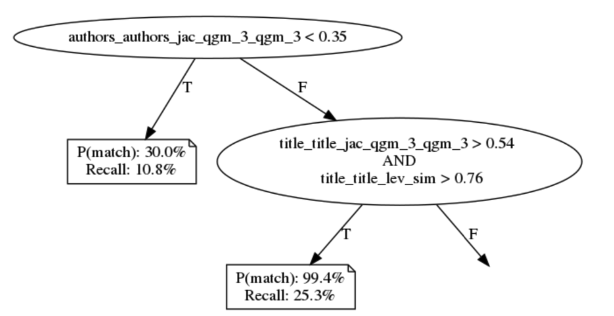
ExplainER
A. Ebaid et al. ExplainER: Entity Resolution Explanations. ICDE Demo, 2019.
M. T. Ribeiro et al. Why should I trust you: Explaining predictions of any classifier. In SIGKDD, pp. 1135—1144, 2016.
Output
Local explanations
(e.g., how different features contribute to a single match prediction – based on LIME)
Global explanations
Approximate the model with an interpretable representation
(e.g., Bayesian Rule List -- BRL)
Representative examples
Small, diverse set of <input, output> tuples to illustrate where the model is correct or wrong
Differential analysis
Compare with another ER model (find disagreements, compare performance, etc.)
Input
B. Letham et al. Interpretable classifiers using rules and Bayesian analysis. Annals of Applied Stat., 9(3), pp. 1350-1371, 2015.
Black-box ER model
Datasets to match
ExplainER

Slide 30
Tutorial Outline
Explainability
Crowd-sourcing
Active Learning
Deep Learning

Slide 31
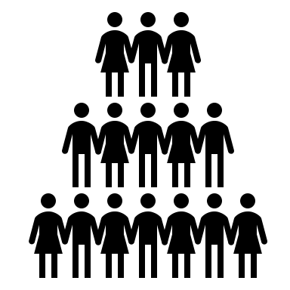
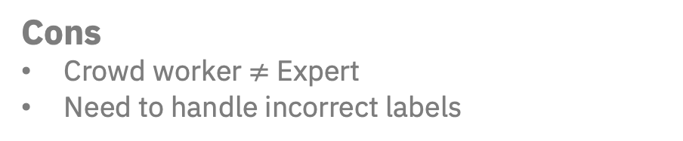
ER Workflow with Crowdsourcing
Basic Idea
Break ER into small human intelligence tasks (HIT)
Use crowd to solve HIT cheaply
Mentions
Blocking
Pros
Allows for many HITs since crowd can be large
Enables novel ER paradigms (assuming costs are low)
Matching
HIT
Cons
Crowd worker $≠$ Expert
Need to handle incorrect labels
Clustering
Label
Resolved Entities

Slide 32
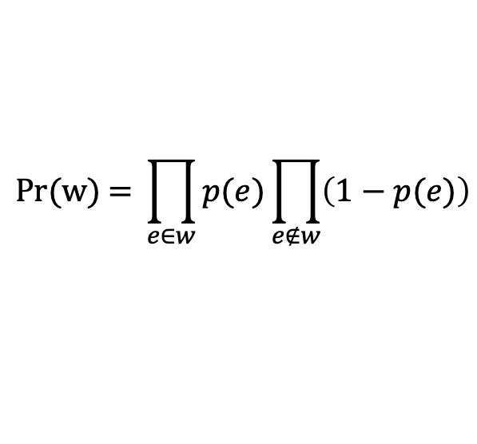
Towards Measuring Utility of a Label
Possible world given by choice of a (sub)set of edges
Probability of a world given by:
May be followed with triangulation
Produces coherent entity clusters
0
0.9
0.1
$$\text{Pr}\text{(}\text{w}\text{) = }\prod_{e∈w}{p(e)\prod_{e∉w}{\left(1−p(e)\right)}}$$
0.6
0.9
0

Slide 33
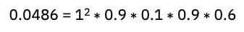
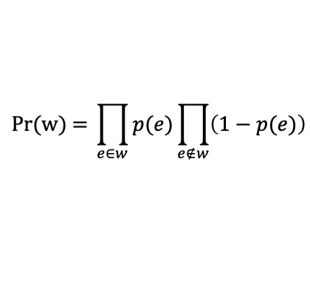
Possible Worlds
0.0036 = 1² $∗$ (1-0.9) $∗$ (1-0.1) $∗$ (1-0.9) $∗$ (1-0.6)
0
0.0054
0.0324
0.9
0.1
0.0324
0.0004
0.6
0.9
0.0486
0.0036
0.0006
0.2916
0.0036
0.0486
0
$$\text{Pr}\text{(}\text{w}\text{) = }\prod_{e∈w}{p(e)\prod_{e∉w}{\left(1−p(e)\right)}}$$
0.0054
0.0054
0.4374
0.0324
0.0486 = 1² $∗$ 0.9 $∗$ 0.1 $∗$ 0.9 $∗$ 0.6

Slide 34
Triangulated Possible Worlds
0.0036
0.0324
0.0004
0.0054
0.0324
0
0.9
0.1
triangulation
0.6
0.9
0.2916
0.0486
0
0.0582 = 0.0486
+ 0.0036
+ 0.0006
+ 0.0054
0.0036
0.5238 = 0.0054
+ 0.4374
+ 0.0324
+ 0.0486
0.0486
0.0036
0.0054
0.4374
0.0006
0.0054
0.0324
0.0486

Slide 35
Outline
Crowdsourcing enables novel ER paradigms such as treating each ER task as a one-off, hands-off crowdsourcing
Especially when treating each ER task as a one-off, reducing HITs is central
Labels can be inferred
We also summarize techniques to mitigate crowd labeling errors
Crowdsourced ER has also addressed other steps of the ER workflow
Blocking
Active learning
crowd-sourced
inferred
crowdsourced

Slide 36
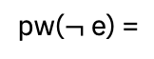
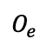
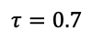
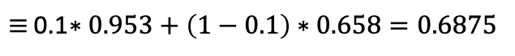
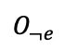
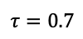
Utility of a Label: Expected Accuracy
[Whang et al, PVLDB’13]
ER Algorithm: Run transitive closure with e if p(e) $≥τ$
$$τ=0.7$$
$$O_{e}$$
$$τ=0.7$$
$$O_{¬e}$$
0.9
1
0.9
0
0.6
0.9
0.6
0.9
pw(e) =
pw($¬$e) =
Utility(e) = p(e)$∗E_{w\sim pw\left(e\right)}\left[\text{FScore}\left(O_{e},w\right)\right]$ + (1-p(e)) ${∗E}_{w\sim pw\left(¬e\right)}\left[\text{FScore}\left(O_{¬e},w\right)\right]$
$≡$ 0.1$∗0.953+\left(1−0.1\right)∗0.658=0.6875$
Measures utility of crowdsourcing a pair of records in the context of an ER algorithm
Computationally intractable
Although sampling and re-use can improve speed
Question Selection for Crowd Entity Resolution by Whang, Lofgren and Garcia-Molina in PVLDB 2013.

Slide 37
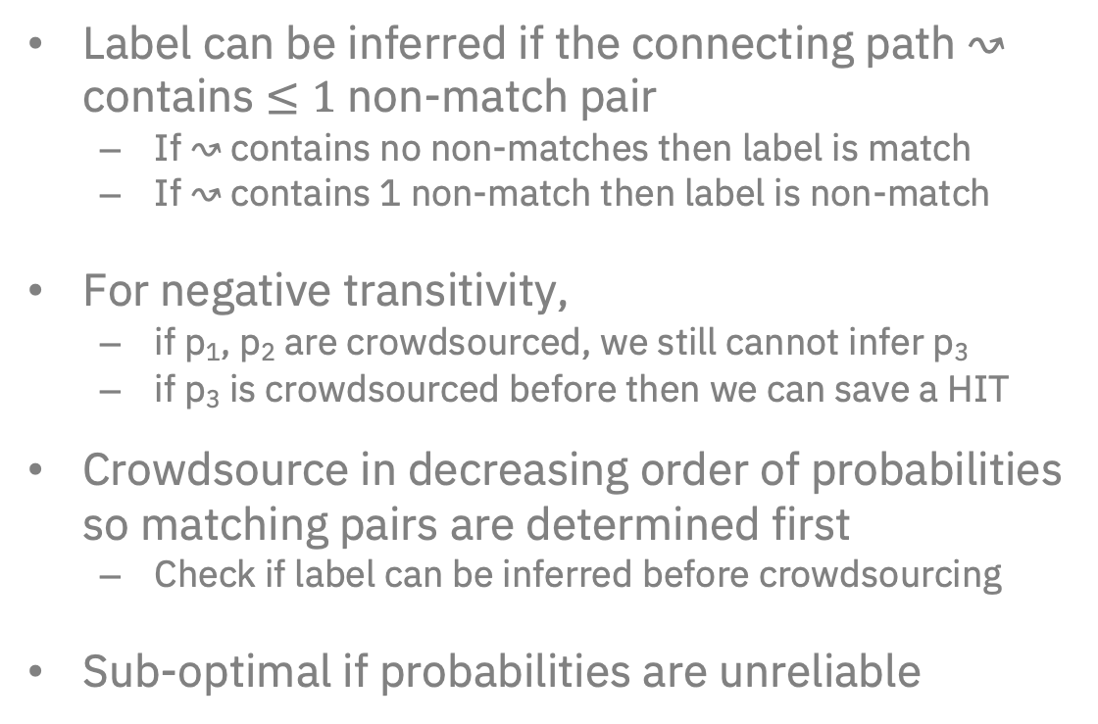
Towards a Practical Crowdsourcing Strategy
[Wang et al, SIGMOD’13]
Positive Transitive Relation
Label can be inferred if the connecting path $↝$ contains $≤1$ non-match pair
If $↝$contains no non-matches then label is match
If $↝$contains 1 non-match then label is non-match
For negative transitivity,
if p₁, p₂ are crowdsourced, we still cannot infer p₃
if p₃ is crowdsourced before then we can save a HIT
Crowdsource in decreasing order of probabilities so matching pairs are determined first
Check if label can be inferred before crowdsourcing
Sub-optimal if probabilities are unreliable
crowd-sourced
inferred
crowdsourced
Negative Transitive Relation
r₃
crowd-sourced
inferred
p₁
p₂
r₂
p₃
r₁
crowdsourced
(r₂,r₁) , (r₃,r₂) → (r₃,r₁)
(r₃,r₂), (r₃,r₁) ↛ (r₂,r₁)
Leveraging Transitive Relations for Crowdsourced Joins by Wang, Li, Kraska, Franklin and Feng in SIGMOD 2013.

Slide 38
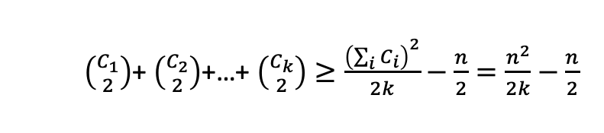
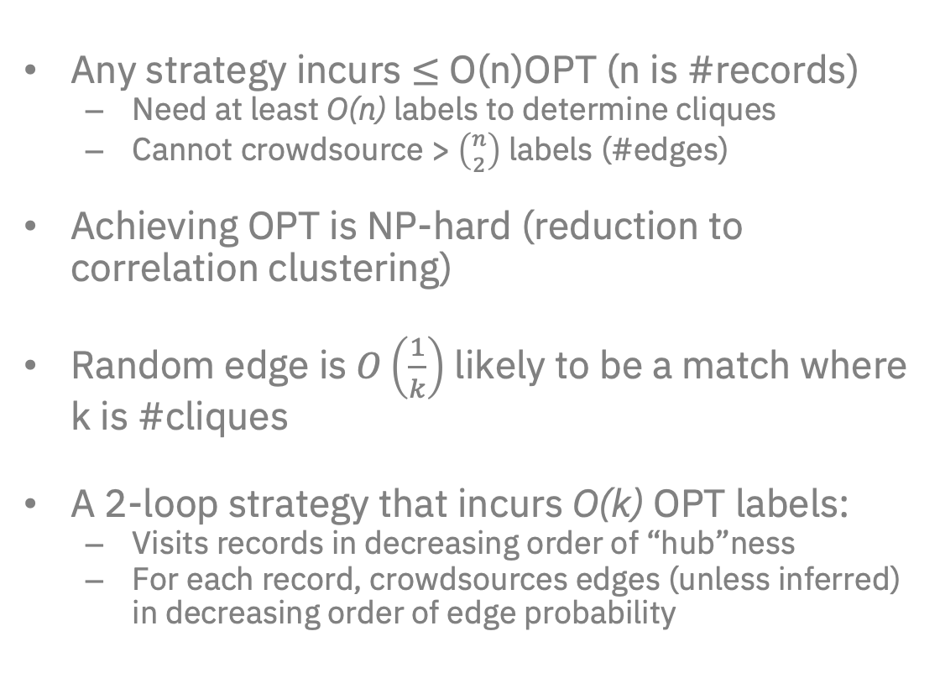
Towards Crowdsourcing Strategies with Guarantees
[Vesdapunt et al, PVLDB’14]
Any strategy incurs $≤$ O(n)OPT (n is #records)
Need at least O(n) labels to determine cliques
Cannot crowdsource > $\left({n \atop 2}\right)$ labels (#edges)
Achieving OPT is NP-hard (reduction to correlation clustering)
Random edge is $O\left(\frac{1}{k}\right)$ likely to be a match where k is #cliques
A 2-loop strategy that incurs O(k) OPT labels:
Visits records in decreasing order of “hub”ness
For each record, crowdsources edges (unless inferred) in decreasing order of edge probability
Within clique edges:
$\left({C_{1} \atop 2}\right)$+ $\left({C_{2} \atop 2}\right)$+…+ $\left({C_{k} \atop 2}\right)≥\frac{{\left(\sum_{i}{C_{i}}\right)}^{2}}{2k}−\frac{n}{2}=\frac{n^{2}}{2k}−\frac{n}{2}$
An O(k) OPT Crowdsourcing Strategy
Crowdsourcing Algorithms for Entity Resolution by Vesdapunt, Bellare and Dalvi in PVLDB 2014.

Slide 39
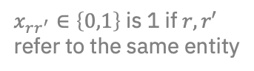
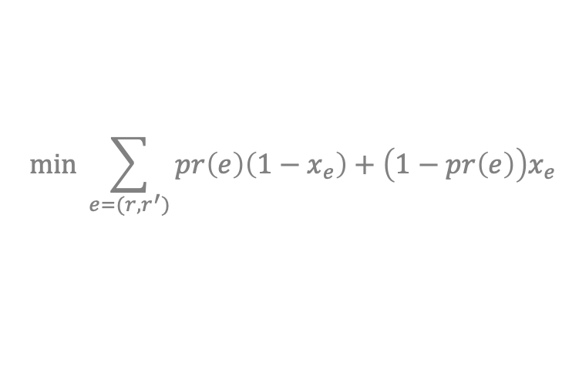
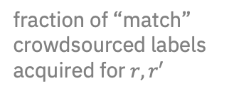
Clustering Algorithms for Crowdsourced ER
Any clustering algorithm may be used to perform entity clustering such as
Correlation clustering does not need specifying clusters [Wang et al, SIGMOD’15]
Another option is maximum likelihood (ML) clustering [V. and G.-M., ICDE’15]
Devise techniques to choose next HIT (under certain assumptions)
$x_{rr^{′}}∈\left\{0,1\right\}$ is 1 if $r,r′$ refer to the same entity
Cluster₁
Cost = 0.9
0.9
0.1
$$mi\text{n} \sum_{e=(r,r^{′})}{pr\left(e\right)\left(1−x_{e}\right)+\left(1−pr\left(e\right)\right)x_{e}}$$
0.6
0.9
fraction of “match” crowdsourced labels acquired for $r,r′$
Cluster₂
Crowd-based Deduplication: An Adaptive Approach by Wang, Xiao and Lee in SIGMOD 2015.
Entity Resolution with Crowd Errors by Verroios and Garcia-Molina in ICDE 2015.

Slide 40
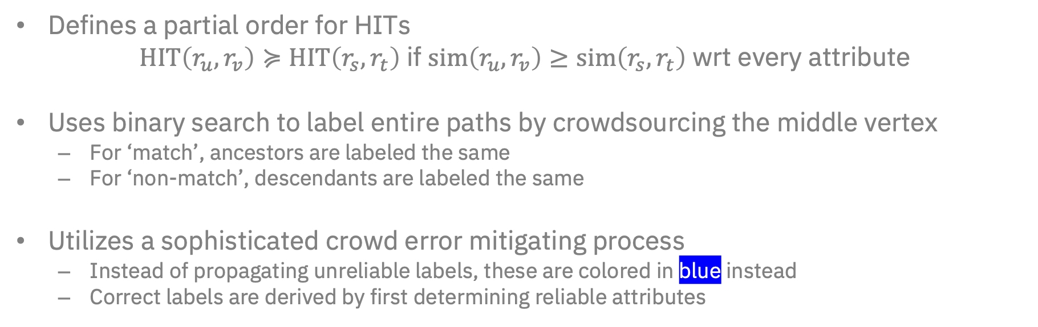
Using Partially-ordered HITs for Crowdsourced ER
[Chai et al, SIGMOD’16]
r₁,r₂
r₁,r₂
r₁,r₂
r₁
r₃,r₄
r₂,r₃?
r₃,r₄
r₃,r₄?
r₃,r₄
0.9
0.1
0.6
0.9
r₂,r₃
r₂,r₃
match
r₂,r₃
r₂
r₄
non-match
r₃
r₁,r₃
r₁,r₃
r₁,r₃
Defines a partial order for HITs
$\text{HIT}\left(r_{u},r_{v}\right)≽\text{HIT}\left(r_{s},r_{t}\right)$ if $\text{s}\text{im}\left(r_{u},r_{v}\right)≥\text{sim}\left(r_{s},r_{t}\right)$ wrt every attribute
Uses binary search to label entire paths by crowdsourcing the middle vertex
For ‘match’, ancestors are labeled the same
For ‘non-match’, descendants are labeled the same
Utilizes a sophisticated crowd error mitigating process
Instead of propagating unreliable labels, these are colored in blue instead
Correct labels are derived by first determining reliable attributes
Cost-Effective Crowdsourced Entity Resolution: A Partial-Order Approach by Chai, Li, Li, Deng and Feng in SIGMOD 2016.

Slide 41
Design of a HIT
[Wang et al, PVLDB’12]
A Standard HIT for crowdsourced ER
Standard (pairwise) HIT is wasteful, expensive
Cluster-based HIT can obtained multiple labels, is more cost-effective
Dividing all pairwise HITs into fewest cluster-based HITs is NP-Hard (reduction from minimum clique cover)
A Cluster-based HIT
CrowdER: Crowdsourcing Entity Resolution by Wang, Kraska, Franklin and Feng in PVLDB 2012.

Slide 42
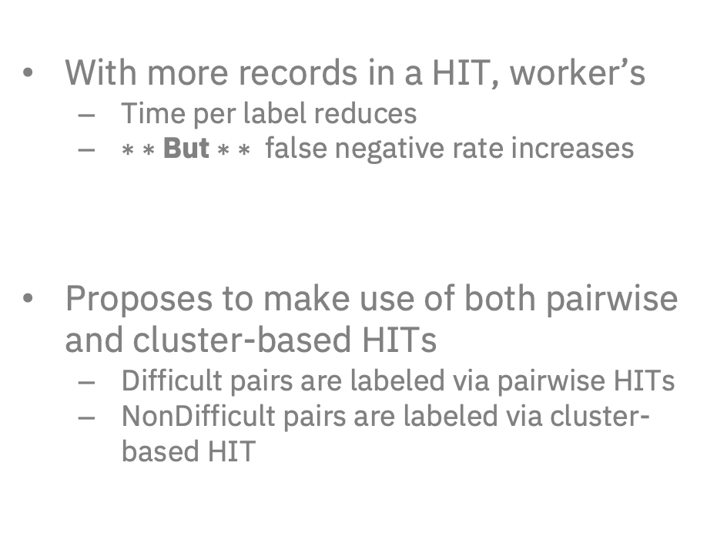
Are All HITs the Same? No.
[Verroios et al, SIGMOD’17]
With more records in a HIT, worker’s
Time per label reduces
$∗ ∗$But $∗$ $∗$ false negative rate increases
Proposes to make use of both pairwise and cluster-based HITs
Difficult pairs are labeled via pairwise HITs
NonDifficult pairs are labeled via cluster-based HIT
Waldo: An adaptive human interface for crowd entity resolution by Verroios, Garcia-Molina and Papakonstantinou in SIGMOD 2017.

Slide 43
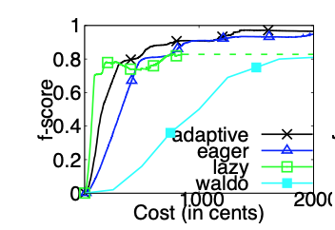
Beyond Majority Voting: Robust Entity Resolution
[Galhotra et al, SIGMOD’18]
Cluster 1
Instead of relying on a single crowdsourced label to connect two entity clusters
Randomly chooses other edges to crowd source labels for
“Strengthens” the connection between two entity clusters
If a label was wrong, then other edges still connect clusters
Theoretically modelled using edge expander graphs
r₂
•
r₁
•
•
s₁
•
s₂
Cluster 2
Robust Entity Resolution using Random Graphs by Galhotra, Firmani, Saha and Srivastava in SIGMOD 2018.

Slide 44
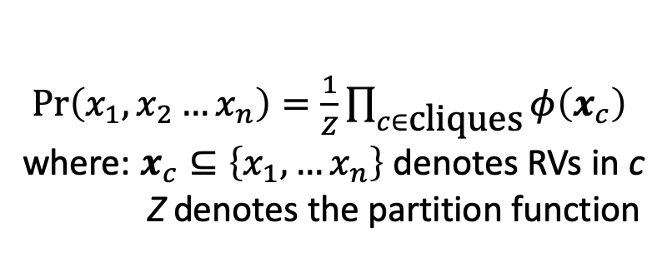
Joint Modeling for Crowdsourced ER
Factor Graph* is a convenient formalism to define joint probabilistic distribution
Allows users to easily express constraints such as positive & negative transitivity
Joint distribution is expressed as product of local functions (factors) expressed over cliques of random variables (RV)
Associated with a graph structure where square and circled nodes refer to factors and RVs, resp.
Practical inference algorithms (e.g., for marginal probabilities) include sum-product algorithm
$\text{Pr}\left(x_{1},x_{2}…x_{n}\right)=\frac{1}{Z}\prod_{c∈\text{cliques}}{φ\left(x_{c}\right)}$
where: $x_{c}⊆\left\{x_{1}, …x_{n}\right\}$ denotes RVs in c
Z denotes the partition function
Update rules of the sum-product algorithm
*Factor Graphs and the Sum-Product Algorithm by Kschischang, Frey and Loeliger in IEEE Transactions on Information Theory 2001.

Slide 45
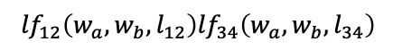

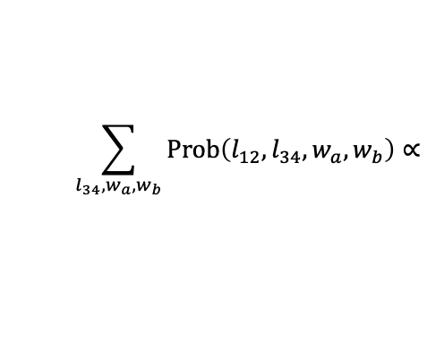
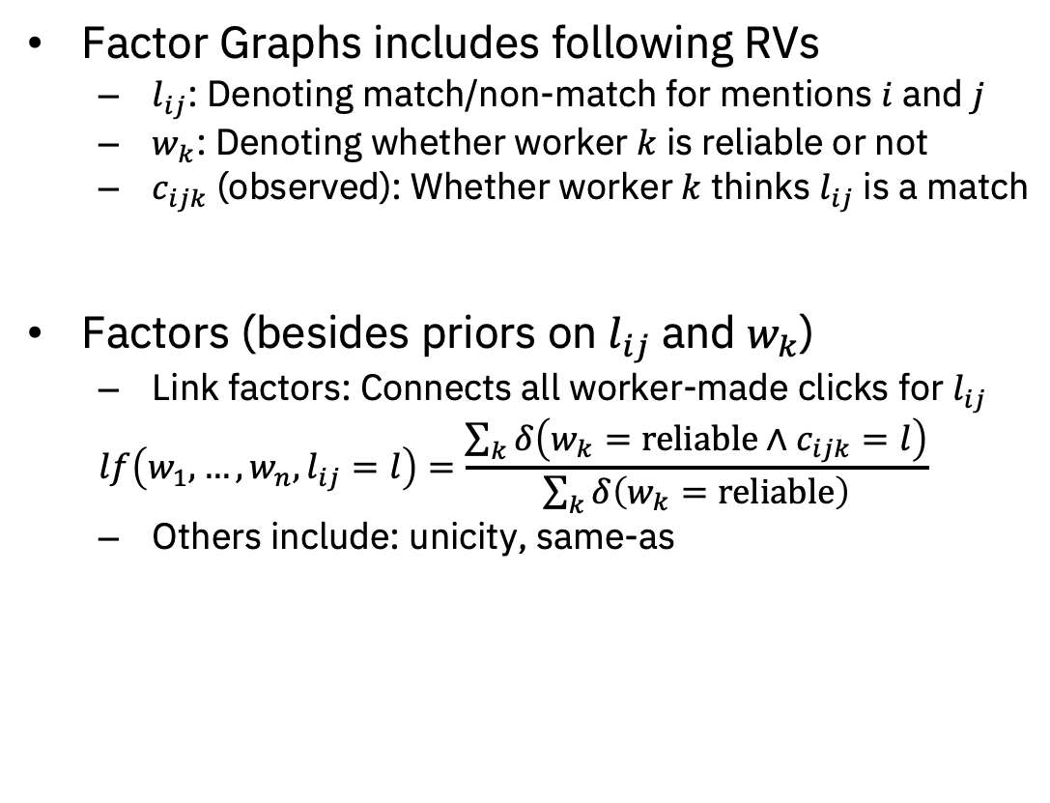
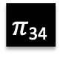

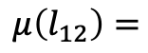
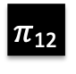
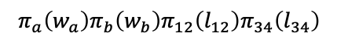
Probabilistic Model for Handling Crowd Errors
[Demartini et al, WWW’12]
Factor Graphs includes following RVs
$l_{ij}$: Denoting match/non-match for mentions $i$ and $j$
$w_{k}$: Denoting whether worker $k$ is reliable or not
$c_{ijk}$ (observed): Whether worker $k$ thinks $l_{ij}$ is a match
Factors (besides priors on $l_{ij}$and $w_{k}$)
Link factors: Connects all worker-made clicks for $l_{ij}$
$$lf\left(w_{1},…,w_{n},l_{ij}=l\right)=\frac{\sum_{k}{δ\left(w_{k}=\text{reliable}∧c_{ijk}=l\right)}}{\sum_{k}{δ\left(w_{k}=\text{reliable}\right)}}$$
Others include: unicity, same-as
?
?
m₄
m₁
m₂
m₃
$$πa$$
$$πb$$
w_{a}
w_{b}
c_{12a}
lf₁₂
c_{12b}
c_{34a}
lf₃₄
c_{34b}
l₁₂
l₃₄
$π$₁₂
$π$₃₄
$$\sum_{l_{34},w_{a},w_{b}}{\text{Prob}\left(l_{12},l_{34},w_{a},w_{b}\right)}∝$$
$${lf}_{12}\left(w_{a},w_{b},l_{12}\right){lf}_{34}\left(w_{a},w_{b},l_{34}\right)$$
$$μ\left(l_{12}\right)=$$
$$π_{a}\left(w_{a}\right)π_{b}\left(w_{b}\right)π_{12}\left(l_{12}\right)π_{34}\left(l_{34}\right)$$
ZenCrowd: leveraging probabilistic reasoning and crowdsourcing techniques for large-scale entity linking by Demartini, Difallah and Cudré-Mauroux in WWW 2012.

Slide 46
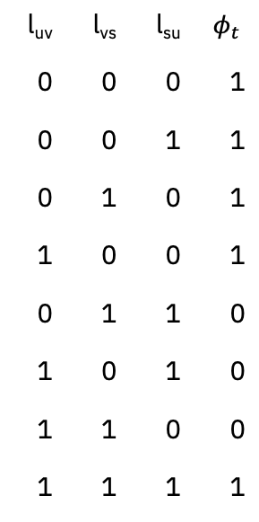

Factor Graphs for Crowdsourced ER: Extensions
Transitivity, partial-order constraints can be expressed as factors
Also possible to have separate link-factors depending on the type of HIT (pairwise or cluster-based)
May allow measuring the utility of a HIT based on how it affects possible worlds
u
l_{uv} | l_{vs} | l_{su} | $$φ_{t}$$
0 | 0 | 0 | 1
0 | 0 | 1 | 1
0 | 1 | 0 | 1
1 | 0 | 0 | 1
0 | 1 | 1 | 0
1 | 0 | 1 | 0
1 | 1 | 0 | 0
1 | 1 | 1 | 1
l_{uv}
l_{su}
v
s
l_{vs}
Negative transitivity
l_{su}
$$φt$$
l_{uv}
l_{vs}
Positive transitivity

Slide 47
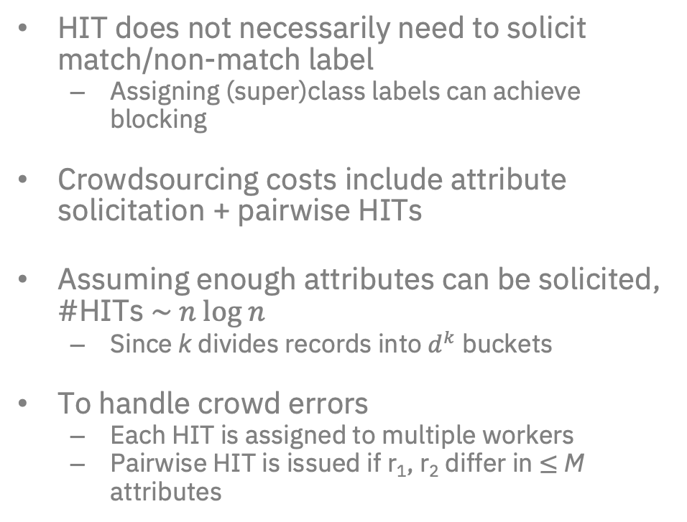
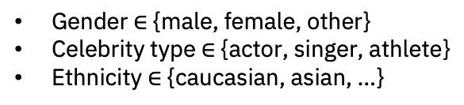
Crowdsourced Blocking Functions
[Khan and Molina, CIKM’16]
HIT does not necessarily need to solicit match/non-match label
Assigning (super)class labels can achieve blocking
Crowdsourcing costs include attribute solicitation + pairwise HITs
Assuming enough attributes can be solicited, #HITs $\sim n \text{log} n$
Since k divides records into $d^{k}$ buckets
To handle crowd errors
Each HIT is assigned to multiple workers
Pairwise HIT is issued if r₁, r₂ differ in $≤$ M attributes
Mentions
Blocking
Matching
Clustering
Resolved Entities
Gender $∈$ {male, female, other}
Celebrity type $∈$ {actor, singer, athlete}
Ethnicity $∈$ {caucasian, asian, …}
Attribute-based Crowd Entity Resolution by Khan and Garcia-Molina in CIKM 2016.

Slide 48
Hands-off Crowdsourced ER
Corleone crowdsources all steps of ER
Blocking is achieved with active learning a random forest
Each root-to-leaf path ending in a non-match label is a potential blocking rule
Active learning is also used to learn a subsequent ER model
Crowd errors are handled by repeatedly polling workers until consensus is achieved
Falcon includes optimizations to improve Corleone’s efficiency
Mentions
Blocking
Matching
Clustering
Resolved Entities
Corleone: Hands-Off Crowdsourcing for Entity Matching by Gokhale, Das, Doan, Naughton, Rampalli, Shavlik, and Zhuin in SIGMOD 2014.
Falcon: Scaling Up Hands-Off Crowdsourced Entity Matching to Build Cloud Services by Das, Suganthan G. C., Doan, Naughton, Krishnan, Deep, Arcaute, Raghavendra, and Park in SIGMOD 2017.

Slide 49



Crowdsourcing ER Models with Active Learning
[Mozafari et al, PVLDB’14]
Lots of Unlabeled data
Learns ER models with active learning
Using Bootstrap, active learning is implemented in a learner agnostic way
A specific example selector (QBC) is implemented with Bootstrap
Any classifier can be learned with active learning without affecting the learning algorithm
Crowd labeling errors can be fatal for active learning
A new PBA algorithm is introduced
Small Training data
Labeled data
Committee of classifiers
Sampling with replacement
Scaling Up Crowd-Sourcing to Very Large Datasets: A Case for Active Learning by Mozafari, Sarkar, Franklin, Jordan, and Madden in PVLDB 2014.

Slide 50
Summary & Open Challenges
Crowdsourced ER has led to a number of works that
Attempt to elucidate how different pairwise decisions are tied together
Improve our understanding of how to evaluate the utility of a HIT
Improve our understanding of HIT design and how it affects worker accuracy
How to handle crowd labeling errors
We lack coherent, principled frameworks for this
Likely to encounter simple techniques (e.g., majority vote) or something new
Can recent work on deep learning with crowds¹ help?
¹Deep Learning from Crowds by Rodrigues and Pereira at AAAI’18

Slide 51
Tutorial Outline
Explainability
Crowd-sourcing
Active Learning
Deep Learning

Slide 52
Active Learning - core concepts
Philosophy:
the learning algorithm incorporates domain knowledge into models from user interactions.
Core components:
Unlabeled data
Training data (optional)
Annotator (human or machine)
Learning algorithm
Active sampling module
Goal: learn high-quality models with minimal human effort
Useful for low-resource settings
Zero or few labeled examples

Slide 53
Passive Learning
Training data
Classic
supervised
learning
Supervised
Learning module
Deployable
model
Key to the success:
Comprehensive and representative
training data!

Slide 54



Active Learning
Candidate
model
Final model
1
Supervised
learning component
Train a candidate model based on available labeled data
Apply the candidate
model to full unlabeled data
2
Interactive
learning
labeled data
unlabeled
full data
5
3
Augment labeled
data with new labels
Find
uncertain
examples
Annotator
Key to the success:
Effective active learning
strategy!
4
Annotate selected
examples

Slide 55
Active Learning for Entity Resolution – move to introduction
Challenges of entity resolution in big data era
Extreme data skewness
Very low matching ratio in realistic ER scenarios
Hard to find positive examples which are crucial for model learning
Labeling data is labor-intensive and error-prone
Domain experts can provide accurate labels but very costly
Crowd is relatively cheap but may provide a lot of noisy labels
Design active learning strategies
that explore different types
of examples in a guided manner
How active learning can help?
Request only necessary labels
from domain experts

Slide 56


Active Learning for ER – representative works
Sarawagi and Bhamidipaty, KDD 2002
Arasu et al., SIGMOD 2010
Chen et al., ICDE 2017, ICDE 2018 (demo)
Tao, PODS 2018
[Magellan] Doan et al., HILDA 2018
[SystemER], Qian et al., CIKM 2017, VLDB 2019 (demo)
Kasai et al., ACL 2019
Buch and Andrzejak, CIKM 2015
Qian et al., ICDE 2018 (demo)
Bhutani et al., COLING 2018
Feature
Engineering
Model
Learning
Matching
Algorithm
Mentions
Blocking
Matching
Clustering
Resolved Entities

Slide 57
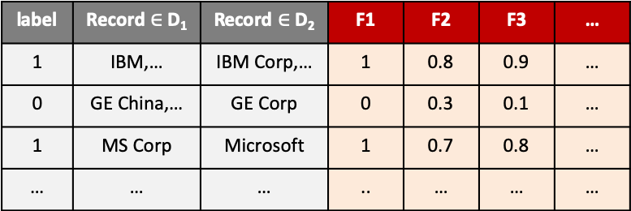
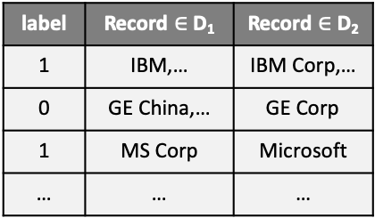
Feature engineering
Goal: augment the labeled data with features extracted by predefined functions.
It’s not necessary for deep learning based approaches
Design and reuse generic/domain-specific
matching/filtering/normalization
functions
companyNameSimilarity
Jaccard similarity
Edit distance similarity
label | Record $∈$D₁ | Record $∈$D₂
1 | IBM,… | IBM Corp,…
0 | GE China,… | GE Corp
1 | MS Corp | Microsoft
… | … | …
label | Record $∈$D₁ | Record $∈$D₂ | F1 | F2 | F3 | …
1 | IBM,… | IBM Corp,… | 1 | 0.8 | 0.9 | …
0 | GE China,… | GE Corp | 0 | 0.3 | 0.1 | …
1 | MS Corp | Microsoft | 1 | 0.7 | 0.8 | …
… | … | … | .. | … | … | …
Feature
Engineering

Slide 58
Different types of matching functions
Ready to use
or can be
fine-tune
Generic
Text based similarity functions (e.g., equality, Jaccard similarity)
Boolean functions (e.g., isNotEmpty, nonNegativeNumber)
Simple normalization function (e.g, toLower, toUpper, strip)
Need to capture sophisticated domain knowledge
Company name normalization functions:
Date time normalization:
Compute geo distances:
IBM, Corp. → IBM Corporation
{Nov. 3, 19 11/03/19 3rd November, 2019} → 2019-11-03
Domain specific
GetDistanceInMiles(“San Francisco, CA”, ”San Jose, CA”)= 48.3
May be learned

Slide 59
Active Learning – Features Engineering for ER
Approximate string matching with active learning
[Buch and Andrzejak, CIKM 2015]
Entity name normalization based on semantic structures
[Nikita et al., COLING 2018]
[Qian et al., ICDE 2018]

Slide 60
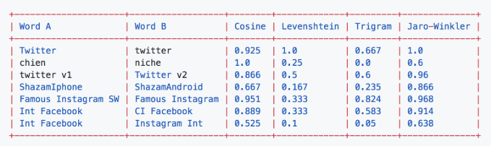

Approximate String Matching with Active Learning
[Buch and Andrzejak, CIKM 2015]
Goal: find the optimal attribute-level string similarity measure (with appropriate threshold) from a given pool
A pool of similarity
measures for APP
names
Cosine
Levenshtein
Trigram
Jaro-Winkler
…
Picture from: https://medium.com/@appaloosastore/string-similarity-algorithms-compared-3f7b4d12f0ff
Both similarity measure and the threshold value are picked by active learning
$$JaroWinkler\left(App_{1}, App_{2}\right)≥0.88$$

Slide 61
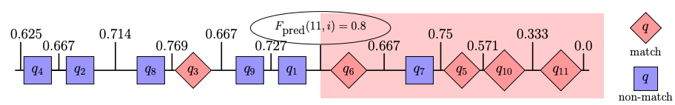
Approximate String Matching with Active Learning
[Buch and Andrzejak, CIKM 2015]
Query strategy: uncertainty-based sampling
(high-level summary): entity pairs whose similarity scores are close to 0.5 are the most uncertain
User labeled examples form a “ground-truth” dataset, which is used to
Pick the optimal similarity measure,
and identify the appropriate threshold values
Vertical lines
means F1-scores
An example of how to find the best threshold value for one similarity measure
1. Rank matches and non-matches
according to their similarity scores
assigned by the measure of interest
2. Find the threshold value that the
resulting function achieves the highest
F1 score over the ground-truth data

Slide 62
Entity name matching based on semantic structure
[Bhutani et al., COLING’18, Qian et al., ICDE’18]
Entity names can be highly ambiguous
General Electric Corporation
General Electric China Corporation
Textually similary, but different entities
General Electric Corporation
GE Corp
Textually dissimilar, but same entities
Textual similarity is not a robust
approach for disambiguation

Slide 63

Entity name matching based on semantic structure
[Bhutani et al., COLING’18, Qian et al., ICDE’18]
General Electric Corporation
General Electric China Corporation
GE Corp
corename
suffix
location
Matching entity names by matching variations
1. Abbreviate suffix
2. Drop suffix
General Electric Corp.
General Electric
General Electric Corporation
Create initials
GE Corporation
Video demo: https://youtu.be/llaT4Sz6uI4
General Electric Corp.
General Electric
GE Corporation
GE Corp.
GE
An active learning based system:
LUSTRE: An Interactive Tool for Entity Structure Learning and Variant Generation.

Slide 64
Active Learning
Sampling Strategy

Slide 65
Active learning strategy is the key component
Goal: identify the most “uncertain” examples to be labeled
Different ways to identify uncertainty
Disagreement in a committee of classifiers
Identify likely false positives and likely false negatives
Find the balance between precision and recall
High entropy
….

Slide 66
Active Learning Strategies
Query-by-committee (QBC)
[Tejada, et al., Information Systems 2001].
[Sarawagi and Bhamidipaty, 2002].
[Isele and Bizer, 2013]
Monotonicity assumption based
[Arasu et al., SIGMOD 2010].
[Chen et al., ICDE 2017, ICDE 2018]
[Tao, PODS 2018]
Likely False Positives/Likely False Negatives (LFP/LFN)
[Qian et al., CIKM 2017], [Qian et al., VLDB 2019]
[Kasai et al., ACL 2019]
Entropy based
[Kasai et al., ACL 2019]
Others
[Magellan]
[Christen et al., PAKDD 2016]

Slide 67
Query-by-committee (QBC)

Slide 68
Query-by-committee – key idea
A committee of classifiers
How to train a committee?
How to identify uncertain examples?
Classifier agnostic
Bootstrap [Mozafari et al]
Randomization
[Sarawagi & Bhamidipaty]
Committee disagreement
Posterior probabilities of classes
Entropy-based
Confidence-based
…
train
Active sampling
Seed training data
Uncertain examples to
be labeled by the user
[Tejada, et al., Information Systems 2001].
[Sarawagi and Bhamidipaty, 2002].
[Isele and Bizer, 2013]
Annotator

Slide 69
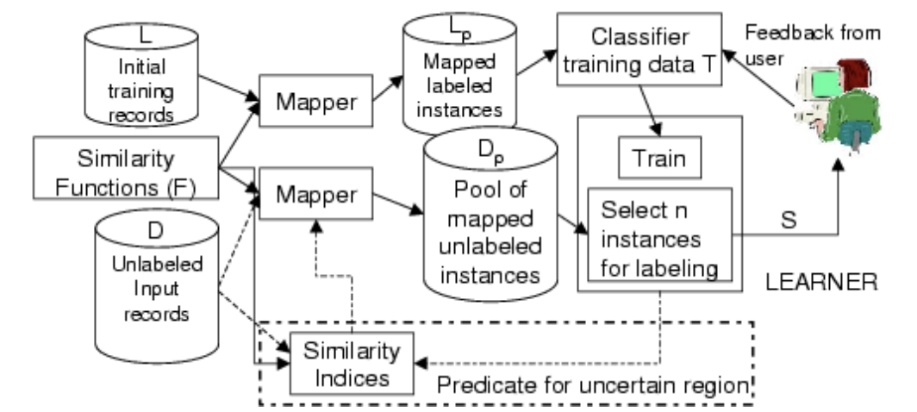
Query-by-committee
[Sarawagi and Bhamidipaty, 2002]
A committee of
randomized decision trees
Key idea
Select examples that the committee has the most degree of disagreement

Slide 70
Sampling strategies based on the monotonicity of precision

Slide 71
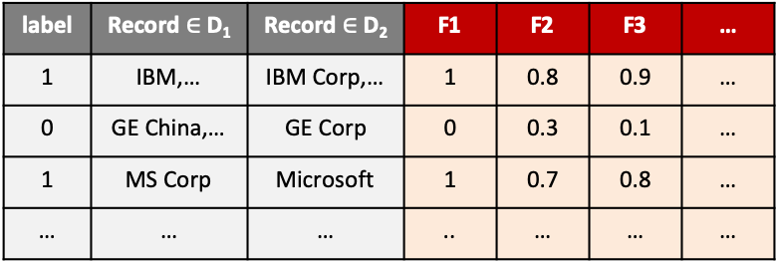




On Active Learning of Record Matching Packages
companyNameSimilarity
[Arasu et al., SIGMOD 2010]
Jaccard similarity
edit distance similarity
Jaro Winkler similarity
companyName similarity
……
Jaccard similarity
Edit distance similarity
label | Record $∈$D₁ | Record $∈$D₂
1 | IBM,… | IBM Corp,…
0 | GE China,… | GE Corp
1 | MS Corp | Microsoft
… | … | …
label | Record $∈$D₁ | Record $∈$D₂ | F1 | F2 | F3 | …
1 | IBM,… | IBM Corp,… | 1 | 0.8 | 0.9 | …
0 | GE China,… | GE Corp | 0 | 0.3 | 0.1 | …
1 | MS Corp | Microsoft | 1 | 0.7 | 0.8 | …
… | … | … | .. | … | … | …
Textual-based similarity functions
$F=\{f_{1}, …, f_{d}\}$
$$\left(r,s\right)$$
$$\overline{F}\left(r,s\right)= <f_{1},…, f_{d}> ∈{\left[0,1\right]}^{d}$$
Given a precision threshold $β$
learn a threshold-based Boolean function $F$ such that $F$ achieves the highest recall with $Precision\left(F\right)≥β$:
$$(JaccardSimilarity\left(name\right)≥0.7∧JaccardSimilarity\left(stree\right)≥0.6)∨(Equality\left(Phone\right))$$
How to find out the combinations of matching functions as well as the appropriate threshold values?

Slide 72


Sampling strategy
[Arasu et al., 2010]
Assumption: monotonicity of precision
Given two threshold-based boolean functions
$$F=F_{i}≥θ_{i}∧…∧F_{d}≥θ_{d}$$
$$G=F_{i}≥γ_{i}∧…∧F_{d}≥γ_{d}$$
The following holds:
$$Precision \left(F\right)≥Precision \left(G\right) if θ_{i}≥γ_{i} , 1≤i≤d$$

Slide 73



Sampling strategy
High precision
Low recall
[Arasu et al., 2010]
If the monotonicity assumption hold, then
$$Precision\left(C1\right)>Precision(C2)$$
If both $C1$ and $C2$ satisfy the precision threshold,
then $C2$ is preferred.
low precision
high recall
The problem becomes finding the set of lowest possible threshold values ($θ^{′}s$) that achieve certain precision threshold (e.g., 90%)
Notes:
Precision score - > threshold

Slide 74





Exploring the ideal set of threshold values
[Arasu et al., 2010]
Core idea: finding the the set of threshold values using binary search
Each point corresponds to a
conjunction of predicates (i.e., rule)
Find the threshold value
via binary search
All Boolean functions in this region
has precision > $P′$
All Boolean functions in this region
has precision < $P′$
Similar idea adopted in [Tao, PODS 2018] as well.

Slide 75

HUMO
[Chen et al. ICDE 2017, ICDE 2018]
Monotonicity assumption also used in HUMO
Pair similarity interval is divided into three disjoint intervals
Non-matches
matches
uncertain
Find out the boundary with active learning

Slide 76
Likely False Negatives / Likely False Positives

Slide 77




Likely False Positives/Likely False Negatives
[Qian et al., 2017, 2019]
SystemER: A human-in-the-loop system for explainable entity resolution.
Explainable entity resolution algorithms (rule-based)
Low-cost human-in-the-loop
corporation | Zip | City | address
Trader Joe’s | 95118 | San Jose | 5353 Almaden Express Way
company | Zip | City | address
Trader Joe’s | 95110 | San Jose | 635 Coleman Ave
Candidate rule learning
R.corporation = S.company
and R.city = S.city
Rule Learning
Algorithm
refinement
R.corporation = S.company
and R.city = S.city
and R.zip = S.zip
Example Selection
corporation | Zip | City | address
KFC | 90036 | LA | 5925 W 3rd St.
company | Zip | City | address
KFC | 90004 | LA | 340 N Western Ave
User labeling
It’s not a match

Slide 78
SystemER: Find Likely False Positives
A few labeled examples
To refine R1 so that it becomes high-precision,
we need to find some examples from the links of R1
that are likely to be false positives
1 candidate rule R1
Enhance precision
U: D₁ x D₂
+
+
+
-
-
-
+ +
-
-
+
+ +
+
Q. This allows us to have one
high-precision rule, how to find more rules?
A. Learn from false negatives
+
+
+
+
Links(R1)
+
+
+
+
+
+
+
+
Finding likely false negatives is challenging
The search space of false negatives is extremely large

Slide 79
SystemER: Find Likely False Positives
A few labeled examples
To refine R1 so that it becomes high-precision,
we need to find some examples from the links of R1
that are likely to be false positives
1 candidate rule R1
Enhance precision
Rule-Minus heuristic: relax the candidate rule by
removing one of its matching predicates.
U: D₁ x D₂
+
-
Rule-Minus3
+
+
-
-
-
+
i.firstName = t.first
AND i.city = t.city
AND i.lastName = t.last
+
+ +
-
R1:
+ +
+
+
+
+
+
Links(R1)
+
+
+
Rule-Minus1
+
+
+
Rule-Minus1
Rule-Minus2
+
i.firstName = t.first
AND i.city = t.city
AND i.lastName = t.last
i.firstName = t.first
AND i.city = t.city
AND i.lastName = t.last
Rule-Minus2
+
+
+
+
Rule-Minus3
+
i.firstName = t.first
AND i.city = t.city
AND i.lastName = t.last
Rule minus rules R1
-> explore likely false negatives of R1
-> enhance recall

Slide 80

Active Learning for ER with Guarantees
Bellare et al, KDD’12
Only active learning approach with guarantees on label complexity
Maximizes recall while constraining precision to be greater than a threshold
Utilizes IWAL [Beygelzeimer et al, ICML’09], an accuracy maximizing active learner with guarantees on label complexity
Guaranteed to make ${\text{log}}^{2}n$ calls, where n denotes the number of pairs (post blocking)
Label complexity of IWAL is sublinear in n only when certain distributional assumptions hold
In practice, takes too many labels to learn an ER classifier [Mozafari et al, PVLDB’14]

Slide 81
Entropy based strategy

Slide 82
Low-resource Deep Entity Resolution
Kasai et al. proposed a deep learning based model for low-resource entity resolution.
low-resource: limited number of labeled examples
Proposed a framework that combines both transfer learning and active learning
Transfer learning: learn a transferrable model from a similar high-resource scenario
To be discussed in next section
Active learning: to adapt the transferred model by iteratively labeling “informative” examples from the target.
Challenge 1: Need substantial positive/negative examples to tune the DL model.
Challenge 2: Hard to improve recall in ER (Qian et al. 2017).
Notes:
Again, active learning further refines the transferred model by iteratively labeling “informative” examples from the target. But there are two major issues to achieve this. The problem is we need substantial labeled examples to tune the transferred DL model without overfitting. The second problem is specific to ER. Since the distribution of ER labels is skewed toward the negative, it is hard to find false negatives and to improve recall. In order to address these issues, we propose an entropy-based sampling method.

Slide 83



Entropy-based sampling strategy
[Kasai et al., 2019]
High-confidence examples (without human verification)
Use as weak labels
To mitigate the data hungriness issue of DL model
LFN/LFP examples (verified by human)
To lower the model uncertainty
High-conf. true positives
1.0
Likely false positives
Rank Predictions based
on probability scores
apply
0.5
Likely false negatives
Candidate model
Post-blocking pairs
0.0
High-conf. true negatives
Notes:
Again, active learning further refines the transferred model by iteratively labeling “informative” examples from the target. But there are two major issues to achieve this. The problem is we need substantial labeled examples to tune the transferred DL model without overfitting. The second problem is specific to ER. Since the distribution of ER labels is skewed toward the negative, it is hard to find false negatives and to improve recall. In order to address these issues, we propose an entropy-based sampling method.

Slide 84
Crowdsourcing ER Models with Active Learning
[Mozafari et al, PVLDB’14]
Lots of Unlabeled data
Learns ER models with active learning
Using Bootstrap, active learning is implemented in a learner agnostic way
A specific example selector (QBC) is implemented with Bootstrap
Any classifier can be learned with active learning without affecting the learning algorithm
Crowd labeling errors can be fatal for active learning
A new PBA algorithm is introduced
Small Training data
Labeled data
Committee of classifiers
Sampling with replacement
Scaling Up Crowd-Sourcing to Very Large Datasets: A Case for Active Learning by Mozafari, Sarkar, Franklin, Jordan, and Madden in PVLDB 2014.

Slide 85
References

Slide 86
References
[Tejada, et al., Information Systems 2001]. Learning Object Identification Rules for Information Integration.
[Sarawagi and Bhamidipaty, KDD 2002]. Interactive Deduplication using Active Learning. SIGKDD 2002.
[Isele and Bizer. 2013]. Active Learning of Expressive Linkage Rules using Genetic Programming. Web Semantics: Science, Services and Agents on the World Wide Web (2013), 2–15.
[Arasu et al., SIGMOD 2010]. On Active Learning of Record Matching Packages. SIGMOD 2010.
[Fisher et al., PAKDD 2016]. Active Learning Based Entity Resolution Using Markov Logic. PAKDD 2016.
[Qian et al., CIKM 2017]. Active Learning for Large-Scale Entity Resolution. CIKM 2017
[Qian et al., VLDB 2019]. SystemER: A Human-in-the-loop System for Explainable Entity Resolution. VLDB 2019
[Kasai et al., ACL 2019]. Low-resource Deep Entity Resolution with Transfer and Active Learning. ACL 2019
[Buch and Andrzejak, CIKM 2015]. Approximate String Matching by End-Users using Active Learning. CIKM 2015

Slide 87
Concluding Remarks
Entity Resolution can be complex at every one of its stages (blocking, matching, clustering).
Often conflicting requirements:
needs domain-specific human expertise and guidance,
but small labeled data (small human effort in general),
high accuracy
explainability
The challenge of human-in-the-loop systems is to reach the right mix of
human guidance vs. automation
People are good at either labeling tasks or at giving domain-specific rules (if a domain expert), but the machine is best at tuning to the actual data.

Slide 88
ER Learning with Human in the Loop: The Landscape
Human expertise incorporated in the model
/Explainability
high
Manual algorithm by the expert (e.g., ER rule writing)
Ideally, we want to be here
Supervised learning
- feature engineering
+ can be explainable
Active learning to acquire labels on demand (less labels)
- feature engineering
+ can be explainable (e.g., rules)
Labeling by the expert
Deep learning
(no feature engineering)
- lots of labels
- less explainability
Deep learning
(no feature engineering)
+ Active learning
(less labels)
- less explainability
Crowdsourcing to acquire labels (to train a reusable model)
Crowd-sourcing to run a one-time ER task
(there is no model)
Automatic Tuning
/ Less guidance
low
high

Slide 89
Tutorial Outline
Explainability
Crowd-sourcing
Active Learning
Deep Learning

Slide 90


ER Lifecycle: Revisit
Is it possible to fully/partially automate this step?
Feature
Engineering
Expensive step: Design and reuse generic/domain-specific matching/filtering/normalization functions
Mentions
Blocking
Matching
Clustering
Resolved Entities
Latent
features
Deep Learning

Slide 91
Deep Learning
Deep learning is a branch of machine learning that enables
understanding the world in terms of hierarchy (layers) of concepts.
- Ian Goodfellow and Yoshua Bengio, Deep learning book
Very good at learning representations from raw data
Requires less or no feature engineering
State-of-the-art performance in multitude of domains
[Source: Ian Goodfellow and Yoshua Bengio, Deep learning book]

Slide 92


Deep Learning: Applications
Computer Vision
Natural Language Processing
Other Applications
Classification
Classification
Databases:
Learned indexes
Learned query optimizers
…
Sports
2
Politics
Medical
Object Detection
Language Modeling
Graph Analytics
Node classification
Link prediction
…
Jack and Jill went up the hill
Noun
Conj.
Noun
Verb
Pre.
Det.
Noun
Data Integration
Entity Resolution
Error Detection
…
[https://bit.ly/2MyOV7i]
Artistic Style Transfer
Machine Translation
Jack and Jill went up the hill
&
more
[https://arxiv.org/pdf/1508.06576.pdf]
Jack und Jill gingen den Hügel hinauf
&
more
&
more

Slide 93

Basic DL Models Review: FCN
Fully Connected Networks
Forward propagation
W₁ ,b₁
h = f (W₁x + b₁)
ŷ = g(W₂h + b₂)
f₁
f₂
f₃
y
f₁
W₂ ,b₂
x₁
1
0
1
0
f, g: Activation functions (Sigmoid, Relu, Tanh)
W_{i}, b_{i}: Parameters
x₂
0
1
1
1
f₂
…
…
…
x_{m}
1
1
1
1
Backward propagation
f₃
Training data
W₁ = W₁ - 𝛼𝜕W₁
b₁ = b₁ - 𝛼𝜕b₁
W₂ = W₂ - 𝛼𝜕W₂
b₂ = b₁ - 𝛼𝜕b₂
x_{i}
h
ŷ
input
hidden
output
Objective
L(ŷ,y) = - (y log ŷ + (1-y) log (1-ŷ))
Minimize $\frac{1}{m}\sum_{i=1}^{m}{\text{L}\text{(ŷ,}\text{y}\text{)}}$

Slide 94
Basic DL Models Review: RNN
Recurrent Neural Networks:
Specifically, for sequence data
Recurrent
f₁
ŷ₁
ŷ₂
ŷ_{m}
f₁
f₂
f₃
y
x₁
1
0
1
0
h₂
RNN Cell
h₁
RNN Cell
h_{m-1}
RNN Cell
h_{m}
x₂
0
1
1
1
f₂
…
Sequence
…
…
…
x_{m}
1
1
1
1
f₃
x₁
x₂
x_{m}
Training data
x_{i}
h
ŷ
Natural language processing
Time series analysis
…
input
hidden
output

Slide 95


RNN application: PoS Tagging
Efficient RNN implementations
Input Sentence
LSTM
GRU
PoS Tagging
Noun
Conj.
Noun
Verb
Prep.
Det.
Noun
…
Noun
Conj.
Noun
Verb
Prep.
Det.
Noun
𝞼
𝞼
𝞼
𝞼
𝞼
𝞼
𝞼
h₀
RNN Cell
RNN Cell
RNN Cell
RNN Cell
RNN Cell
RNN Cell
RNN Cell
h₇
Jack
and
Jill
went
up
the
hill
Word embeddings

Slide 96
Word Embeddings
One-hot
Pre-trained
Sparse (or local) representation
35677
35679
Jack →
0
0
0
0
…
0
0
1
0
…
0
|Vocabulary| = #distinct words in the corpus
1
2
3
4
35676
35678
40000
Distributed (or dense) representation
In practice, performs much better to One-hot
1
2
3
4
300
Glove
BERT
Jack →
0.8
-0.1
0.2
0.6
…
-0.9
Context-free
Word2Vec
ELMo
FastText
Context-aware

Slide 97


DL for ER Landscape
Auto-EM: Chen et al., TWC 2019
DeepER: Thirumuruganathan et al., arXiv 2018
Pre-trained
ER Model
+
3
Transfer Learning
Active Learning
DTAL: Kasai et al., ACL 2019
1
2
Distributed
Tuple Representation
DeepMatcher: Mugdal et al., SIGMOD 2017
DeepER: Ebraheem et al., VLDB 2018
Classifier
DeepER: Thirumuruganathan et al., arXiv 2018
Mentions
Blocking
Matching
Clustering
Resolved Entities

Slide 98
How can DL help ER?
Feature Engineering
ER Task:
Traditional ML-based ER techniques rely on features crafted from the human provided blocking and similarity functions.
DL methods can automatically learn features from raw data (text)
Name | WorksAt | KnownFor
Ronald Fagin | IBM Almaden Research Center | Database theory, finite model theory, and reasoning about knowledge
Semantic Similarity
?
Majority of string similarity functions are limited to surface-level syntactic similarity e.g., Jaccard(“Database theory”, “theoretical relational concepts”) = 0
DL models can leverage pre-trained word embeddings that captures semantic similarity e.g., king – man + woman = queen
Name | WorksAt | KnownFor
Ron Fagin | IBM Almaden | finite-model theory, theoretical relational concepts
Transferability
Transfer learning facilitate pre-trained DL models to be applicable for new datasets

Slide 99
Distributed Tuple Representation
[Ebraheem et al., VLDB’18]
Method 1: Tuple as a sequence of words
Name | WorksAt | KnownFor
Ronald Fagin | IBM Almaden Research Center | Database theory, finite model theory, and reasoning about knowledge
Vector representation
Ronald
Fagin
…
Distributed Representation!
Knowledge

Slide 100
Out-of-Vocabulary Retrofitting
[Ebraheem et al., VLDB’18]
In-vocabulary
In-vocabulary words obtain their embeddings directly from dictionary
Out-of-vocabulary
Out-of-vocabulary words’ embeddings are computed via average of top-k co-occurring in-vocabulary words in the ER dataset
In-vocabulary retrofitting
For each in-vocabulary word w_{e}, a corresponding retrofitted embedding w^{r}_{e}, is computed via probabilistic inference such that w^{r}_{e} ≃ w_{e}

Slide 101
Blocking with Distributed Tuple Representations
[Ebraheem et al., VLDB’18]
Basic idea
Use LSH (Locality Sensitive Hashing) for grouping similar tuples
distributed representation
> 0 ⇒ 1
≤ 0 ⇒ 0
…
…
…
…
…
t
g₁
g₂
g_{l}
h₁, h₂, …, h_{m} : random hyperplanes; dim(h_{i}) = dim(t)
g₁, g₂, …, g_{l} : hash codes
Mitigates collisions

Slide 102
Matching with Distributed Tuple Representation
[Ebraheem et al., VLDB’18]
Backpropagation
F1 Performance
Fully connected network
Absolute difference
Hammard Product
Distributed tuple representation

Slide 103
Distributed Tuple Representation via Attribute Encoding
Method 2: Tuple as a set of attributes, each attribute a sequence of text
[Mugdal et al., SIGMOD’18]
Name | WorksAt | KnownFor
Ronald Fagin | IBM Almaden Research Center | Database theory, finite model theory, and reasoning about knowledge
Vector representation
Attribute encoding is not context-aware!
Name
WorksAt
KnownFor
·········· ·········· ··········

Slide 104
Distributed Tuple Representation via Attribute Encoding
Method 2: Tuple as a set of attributes, each attribute a sequence of text
[Mugdal et al., SIGMOD’18]
Context
KnownFor
Database theory, finite model theory, and reasoning about knowledge
Context
KnownFor
Finite model theory theoretical relational concepts
KnownFor
finite-model theory, theoretical relational concepts
KnownFor
Database theory Finite model Theory and reasoning about knowledge
Attention
Sophisticated hybrid approach

Slide 105
Matching with Attribute Encoding
[Mugdal et al., SIGMOD’18]
Structured data
RNN
Attention
Hybrid
Textual data
Back Propagation
Abs. difference
Concatentation
Fully
Connected
Network
Dirty data
State of the art performance well for text & dirty scenarios

Slide 106

DL for ER Performance vs Labeled Data Size
DBLP-ACM
Deep learning models
require a lot of labeled examples to achieve comparable performance to non-DL methods
Many ER scenarios are labeled data scarce:
- expensive labeling effort (non-expert labeling is
error-prone)
- very hard to find positive examples ⇒ class skew

Slide 107
Low-resource Deep ER
Transfer learning
Basic idea:
Learn a model from high-resource ER scenarios (with some regularizations e.g., dropout, etc.)
Transfer and further fine-tune the model using available examples in low-resource setting
Current works:
Reuse and Adaptation for Entity Resolution through Transfer Learning Thirumuruganathan et al. arXiv 2018
Auto-EM: End-to-end Fuzzy Entity-Matching using Pre-trained Deep Models and Transfer Learning Zhao et al. WWW 2019
Transfer learning + Active learning
Basic idea:
Learn a model from high-resource ER scenarios
Use active learning to further fine-tune the model for low-resource setting [low-resource setting has zero or more available labeled examples]
Current works:
Low-resource Deep Entity Resolution with Transfer and Active Learning Kasai et al. ACL 2019

Slide 108
Transfer Learning: Approach 1
[Thirumuruganathan et al. arXiv 2018]
Reuse and Adaptation for Entity Resolution through Transfer Learning
Target
Nothing (T = 𝜙)
Limited
Adequate
Domain adapation ∀x ∈ S, find w_{x} as: w_{x} ≈ 1 iff ∃y ∈ T, x≈y w_{x} ≈ 0 otherwise Build a classifier over S with weighted examples | Feature augmentation | Directly train on T Or Transfer model from S and train on T (for regularization)
 | Semi-supervised domain adapation
Adequate
S
: Source labeled data
T
: Target labeled data
Source
U
: Target unlabeled data
Limited

Slide 109
Transfer Learning: Approach 1
[Thirumuruganathan et al. arXiv 2018]
Reuse and Adaptation for Entity Resolution through Transfer Learning
(Adequate, Nothing)
(Limited, Limited)
(Adequate, Limited)

Slide 110
Transfer Learning: Approach 2
[Zhao et al. TWC 2019]
Auto-EM: End-to-end Fuzzy Entity-Matching using Pre-trained Deep Models and Transfer Learning
Microsoft Satori
(or any Knowledge Graph)
Person
Positive examples: organization entities
Negative examples : entities for type ≠ organization & its correlation types
Type classifier
Hierarchical deep learning model
Organization
EM
Classifier
40 head entities
Hierarchical deep learning model
Book
Positive examples: (entity, synonym) pairs from organization
Negative examples : (entity, entity’) pairs where entity’ is syntactically similar but of different type e.g. (Paris, Paris Hilton)
…

Slide 111
Transfer Learning: Approach 2
[Zhao et al. TWC 2019]
Auto-EM: End-to-end Fuzzy Entity-Matching using Pre-trained Deep Models and Transfer Learning
Type Detection
Entity Matching

Slide 112
Transfer Learning: Approach 2
[Zhao et al. TWC 2019]
Auto-EM: End-to-end Fuzzy Entity-Matching using Pre-trained Deep Models and Transfer Learning
Pretrained
Zero or more labels
Pretrained
Non-type specific attribute-level EM

Slide 113

Low-resource ER: DTAL
[Kasai et al., 2019]
Low-resource Deep Entity Resolution with Transfer and Active Learning
Approach
Transfer learning: Leveraging transferrable models from high-resource to low-resource labeled datasets
Active learning: To further fine-tune transferred models
Source
Transferrable
DL Model
Train
Labeled data
*Covered in Active learning part
Target
Transfer learning
Unlabeled
data
Match/No Match
Uncertain
examples
Label
?
vs.
High-resource dataset
Fine tune
Low-resource dataset
Active learning
Final DTAL ER model
DTAL: Deep Transfer Active Learning

Slide 114

DTAL: Attribute Agnostic Transfer Learning
[Kasai et al., 2019]
High-resource dataset:
Authors | Title | Venue | Year
C Goble, D Roure | Semantic Grid: an Application of the Semantic Web | SIGMOD Record | NA
Authors | Title | Venue | Year
C A Goble, D De Roure | The Grid: an Application of the Semantic Web | ACM SIGMOD Record | 2002
Label
Match
Single GRU useful for
schema agnostic learning
Dataset independent learning
BiGRU
Dataset
Classifier
Gradient Reversal
−
+
−
+
−
+
−
=
Matching
Classifier
Authors
Title
Venue
Year
Transferrable Model

Slide 115
DTAL: Active Learning
Kasai et al. proposed a deep learning based model for low-resource entity resolution.
low-resource: limited number of labeled examples
Proposed a framework that combines both transfer learning and active learning
Transfer learning: learn a transferrable model from a similar high-resource scenario
To be discussed in next section
Active learning: to adapt the transferred model by iteratively labeling “informative” examples from the target.
Challenge 1: Need substantial positive/negative examples to tune the DL model.
Challenge 2: Hard to improve recall in ER (Qian et al. 2017).
Notes:
Again, active learning further refines the transferred model by iteratively labeling “informative” examples from the target. But there are two major issues to achieve this. The problem is we need substantial labeled examples to tune the transferred DL model without overfitting. The second problem is specific to ER. Since the distribution of ER labels is skewed toward the negative, it is hard to find false negatives and to improve recall. In order to address these issues, we propose an entropy-based sampling method.

Slide 116
DTAL: Active Learning
[Kasai et al., 2019]
High-confidence examples (without human verification)
Use as weak labels
To mitigate the data hungriness issue of DL model
LFN/LFP examples (verified by human)
To lower the model uncertainty
High-conf. true positives
1.0
Likely false positives
Rank Predictions based
on probability scores
apply
0.5
Likely false negatives
Candidate model
Post-blocking pairs
0.0
High-conf. true negatives
Notes:
Again, active learning further refines the transferred model by iteratively labeling “informative” examples from the target. But there are two major issues to achieve this. The problem is we need substantial labeled examples to tune the transferred DL model without overfitting. The second problem is specific to ER. Since the distribution of ER labels is skewed toward the negative, it is hard to find false negatives and to improve recall. In order to address these issues, we propose an entropy-based sampling method.

Slide 117
DTAL: Results

Slide 118
Key Takeaways
Deep learning for ER is promising for various reasons that include
Ability to work on raw tuples, requiring less or no feature engineering
Ability to transfer trained models to new datasets that has few training examples
State-of-the-art performance on complex ER tasks
But,
Building DL models from scratch requires a lot of training data
Interpretability for DL models (esp. for ER) is either non-existent or very ad-hoc [active research topic]

Slide 119
Concluding Remarks
Entity Resolution can be complex at every one of its stages (blocking, matching, clustering).
Often conflicting requirements:
needs domain-specific human expertise and guidance,
but small labeled data (small human effort in general),
high accuracy
explainability
The challenge of human-in-the-loop systems is to reach the right mix of
human guidance vs. automation
People are good at either labeling tasks or at giving domain-specific rules (if a domain expert), but the machine is best at tuning to the actual data.

Slide 120
References

Slide 121
References
[Tejada, et al., Information Systems 2001]. Learning Object Identification Rules for Information Integration.
[Sarawagi and Bhamidipaty, KDD 2002]. Interactive Deduplication using Active Learning. SIGKDD 2002.
[Isele and Bizer. 2013]. Active Learning of Expressive Linkage Rules using Genetic Programming. Web Semantics: Science, Services and Agents on the World Wide Web (2013), 2–15.
[Arasu et al., SIGMOD 2010]. On Active Learning of Record Matching Packages. SIGMOD 2010.
[Fisher et al., PAKDD 2016]. Active Learning Based Entity Resolution Using Markov Logic. PAKDD 2016.
[Qian et al., CIKM 2017]. Active Learning for Large-Scale Entity Resolution. CIKM 2017
[Qian et al., VLDB 2019]. SystemER: A Human-in-the-loop System for Explainable Entity Resolution. VLDB 2019
[Kasai et al., ACL 2019]. Low-resource Deep Entity Resolution with Transfer and Active Learning. ACL 2019
[Buch and Andrzejak, CIKM 2015]. Approximate String Matching by End-Users using Active Learning. CIKM 2015

